Slide 1
Roof-ER Sales Training

Slide 2
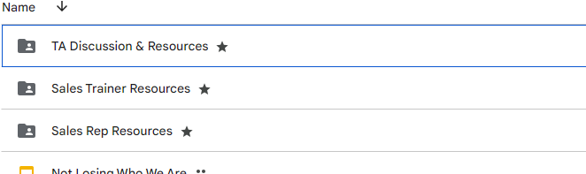
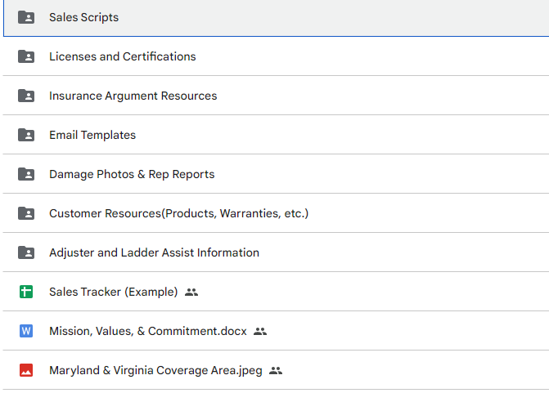
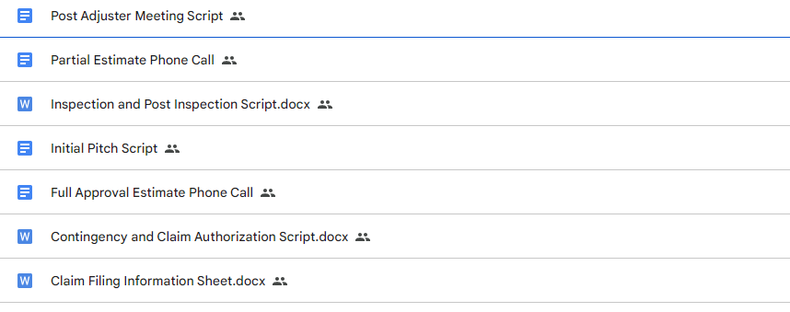
Google Drive

Slide 3
Initial Pitch 5 Non-Negotiables
Who you are
Who we are and what we do (Roof ER)
Make it relatable
What you’re there to do (an inspection)
Go for the close (them agreeing to the inspection)

Slide 4
Initial Pitch
Knocking Etiquette

Slide 5
Initial Pitch
“Hi, how are you? My Name is ________ with Roof- ER we’re a local roofing company that specializes in helping homeowners get their roof replaced, paid for by their insurance!”
Generic:
“We’ve had a lot of storms here in Northern Virginia/Central Virginia/Philadelphia/Maryland over the past few months that have done a lot of damage!
“We’re already working with your neighbors. We’ve been able to help them get fully approved through their insurance company to have their roof replaced.”

Slide 6
Initial Pitch
“While I’m here, in the neighborhood, I am conducting a completely free inspection to see if you have similar, qualifiable damage. If you do, I’ll take a bunch of photos and walk you through the rest of the process. If you don’t, I wouldn’t want to waste your time, I wouldn’t want to waste mine! I will at least leave giving you peace of mind that you’re in good shape.”
Pause here – Wait for them to respond/agree.
Once they agree to let you do the inspection:, “Alright! It will take me about 10 - 15 minutes. I’m gonna take a look around the perimeter of your home, then grab the ladder, and take a look at your roof.
Go in for a handshake. “What was your name again? [Their name] great to meet you, again I am (your name). Oh and by the way do you know who your insurance company is”? Wait for their answer, “Great! We work with those guys all the time.”
“Here’s my card/flier, look us up while I’m conducting the inspection! I will give you a knock when I finish up and show you what I’ve found.”
Without any hesitation, move into inspection. (See Inspection and Post-Inspection Script for detailed next steps.)

Slide 7
Initial Pitch
Break into groups
Switch between Sales Rep and Homeowner
Read the script a few times each

Slide 8
Initial Pitch
Specific
“Were you home for the storm we had in ___. Wait for answer
If yes “It was pretty crazy right?! Wait for answer
If no: “Oh no worries at all, we get that all the time.
If yes move on to next line marked with *
If no “That’s good! It was a pretty bad one.”
*“We’re working with a lot of your neighbors in the area. We’ve been able to help them get fully approved through their insurance company to have their roof replaced.”

Slide 9
Initial Pitch Quiz
What are the 5 Non-Negotiables?
What are the first two sentences of the Initial Pitch?
What are the next 2 in the generic script?
What are the next 3 lines if you are mentioning a specific storm date?
Fill in the blanks: “While I’m here in the neighborhood, I am conducting a _____ _____ ____ __ __ __ __ ____ ______, ________damage.
What are the next 2 sentences after they agree to let you do the inspection?
What is the last sentence of the Initial Pitch Script?

Slide 10
Field Portal App
The Field Portal App will be used mostly on your phone (but is also useable on your iPad)
Later on this week, we will review using the Field Portal App on a laptop or desktop which is the most ideal way to keep your jobs organized
On the Field Portal App, you can:
Track your jobs and what stage they are in
Review Metrics
Pin houses and create leads
Create and upload your Photo reports
Schedule customer-related events
Review Tasks and Messages
Check the Trade Calendar to see when your installs are going up

Slide 11
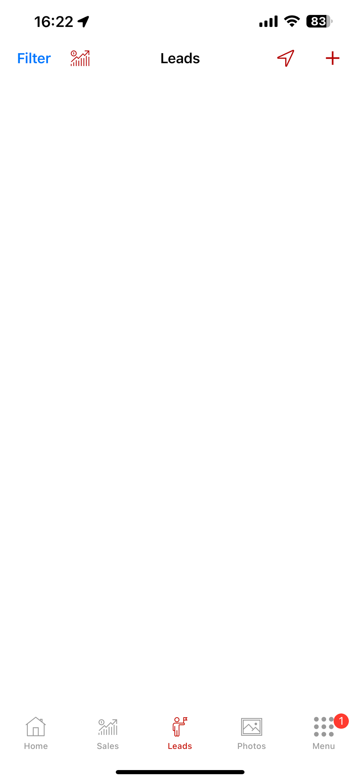
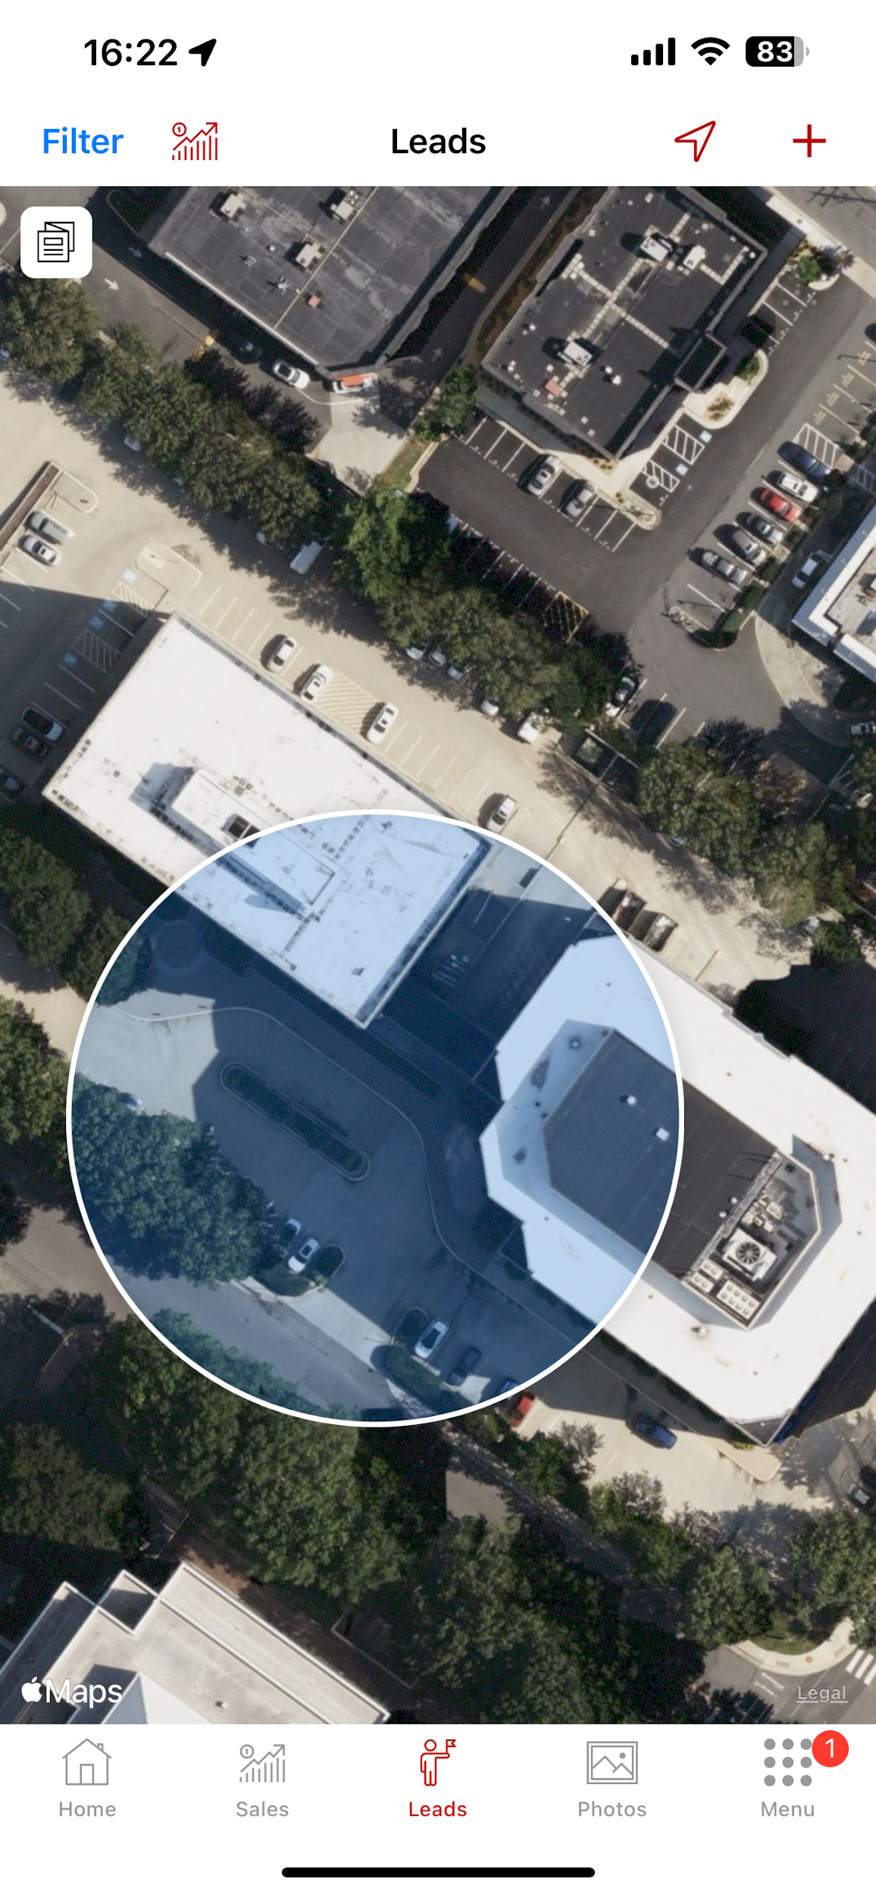
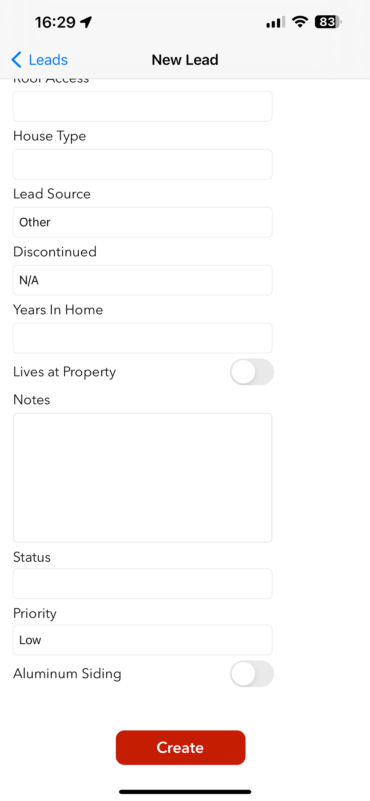
Field Portal App
Pinning Houses

Slide 12
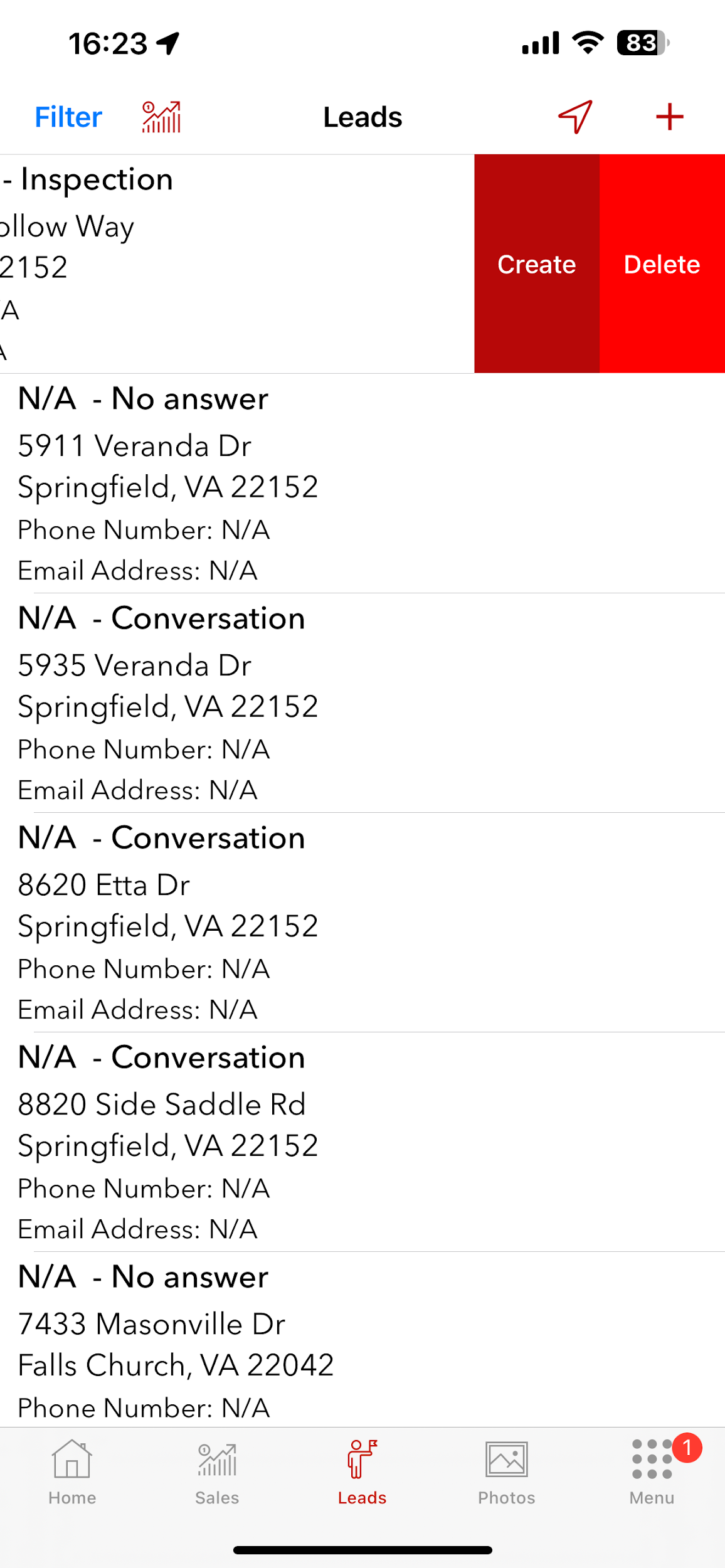
Field Portal App
You can view a list of your door knocks.

Slide 13
Objections
Common Objections
“not interested”
“I need to talk to my spouse”
“I don’t have enough time”
“my roof is in good shape”
“I just had it checked”
“I don’t have the money for anything right now”
“I have a roofer knock my door at least 5 times a week”
“my roof is only 18 years old and is a 50 year roof”
Tips:
Always react positively with an agreeable response and attitude
Ask questions when appropriate
Repeat the customers’ objections when appropriate

Slide 14
Initial Pitch
Please memorize the whole Generic initial pitch
Please also be familiar with the Specific Pitch

Slide 15
Initial Pitch
Pitch and Objection Practice

Slide 16

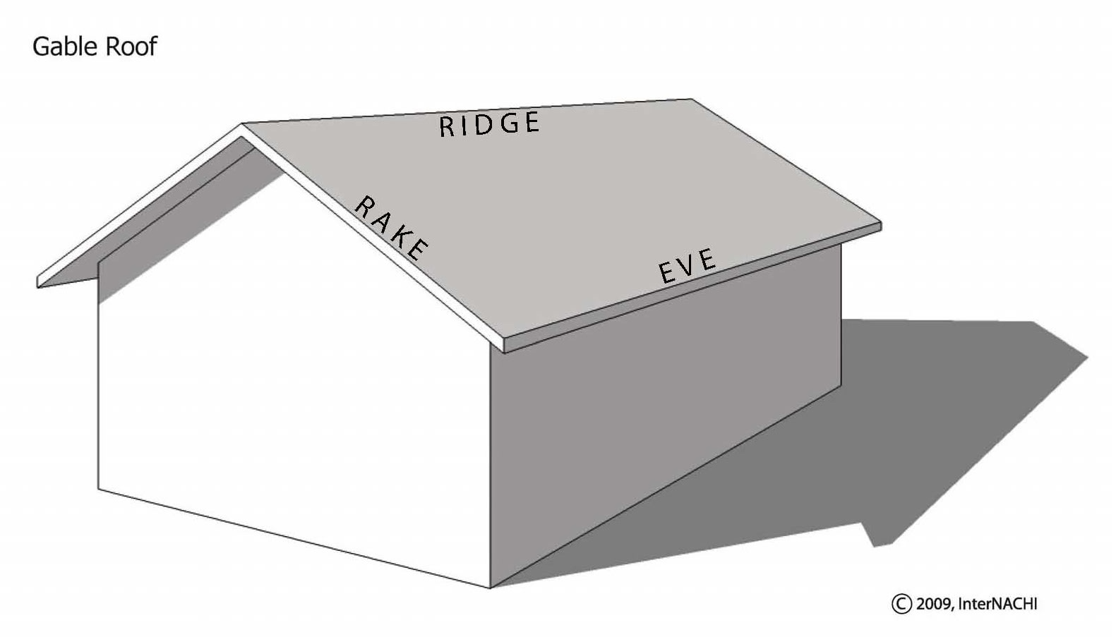
Basic Roofing
Most Common Roofing Material - Asphalt
Other Roofing Material
Metal
Cedar/Wood/synthetic
TPO/EPDM/Rolled Asphalt
Gable Roof
Hipped Roof
Common Terms
Eave
Rake
Ridge

Slide 17
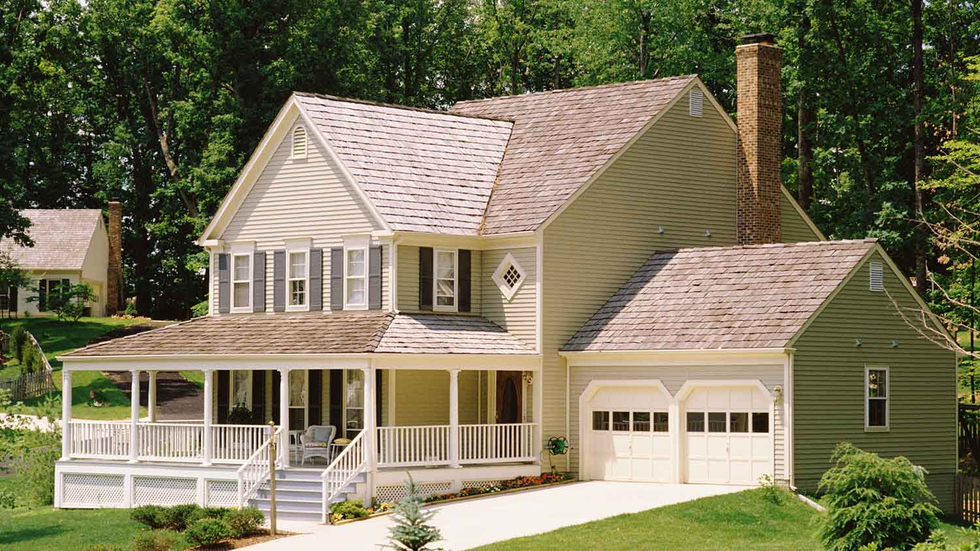
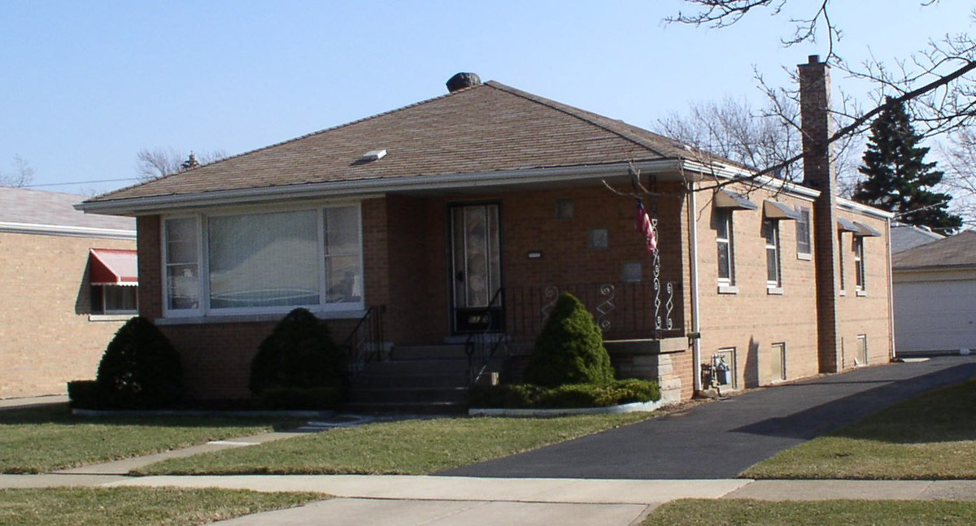
Basic Roofing

Slide 18
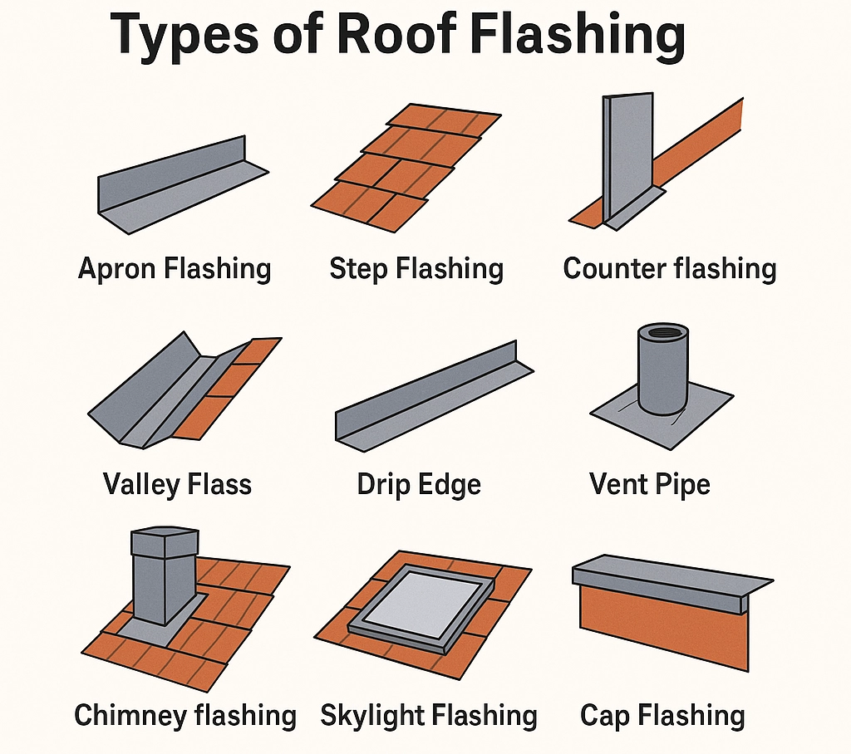
Basic Roofing
Flashing: a thin material, usually metal, that roofers use to direct water away from critical areas of the roof.
Types of Flashing
Step
Counter/Apron
Chimney
Skylight

Slide 19
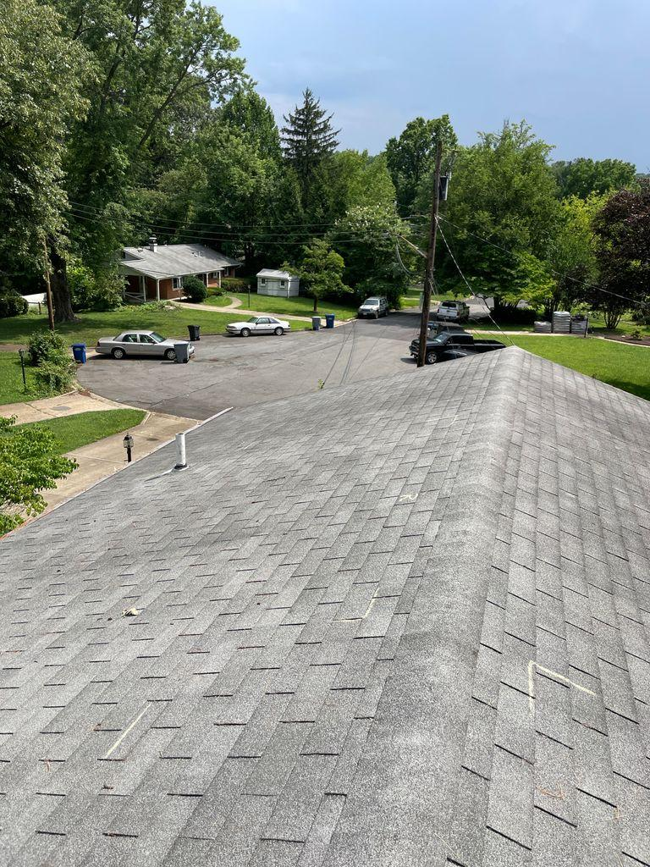
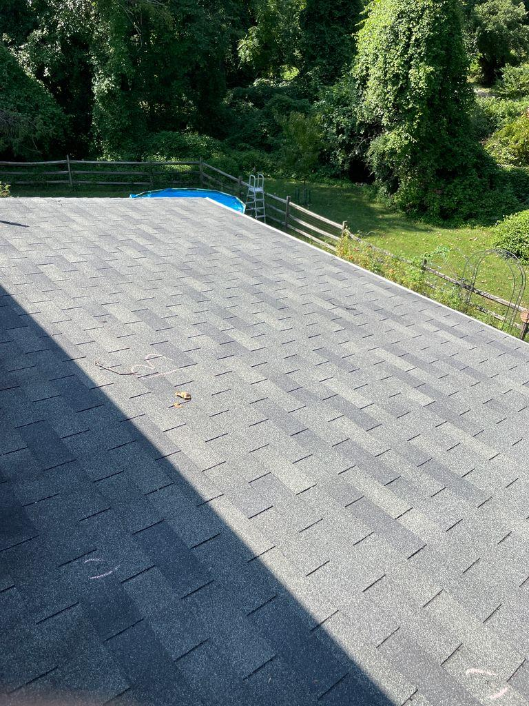
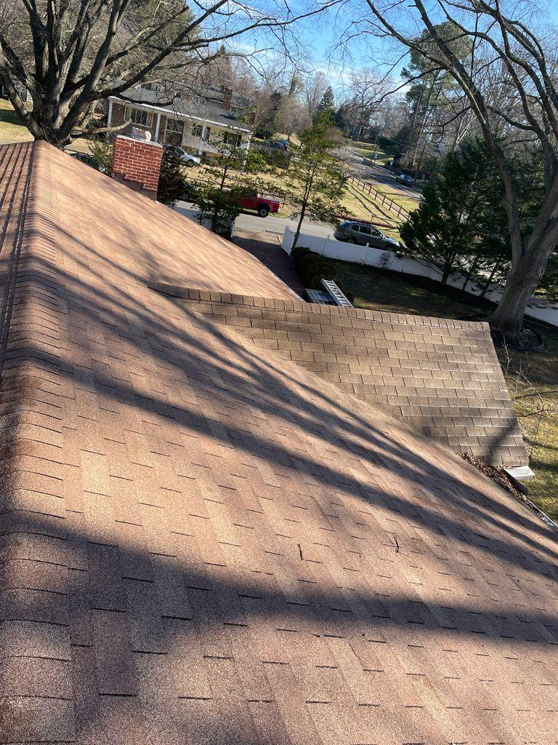
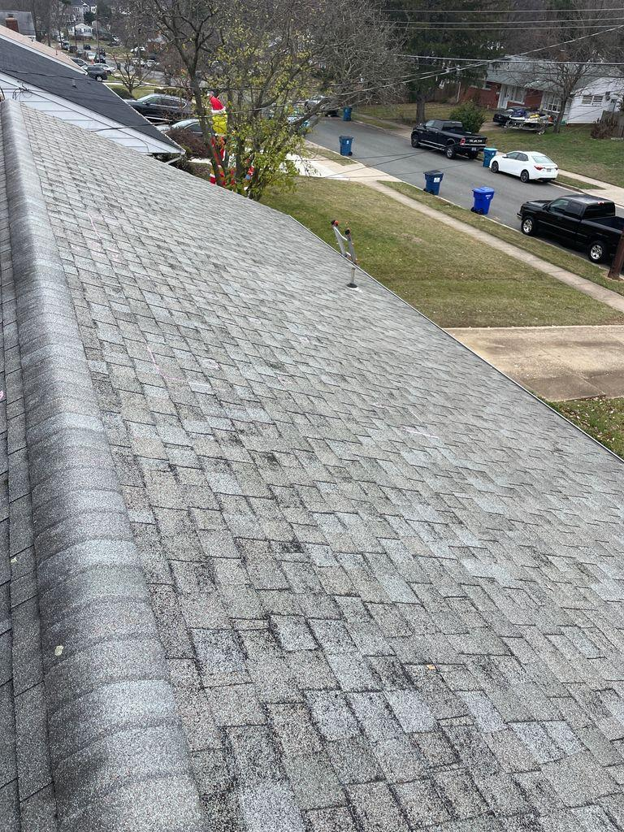
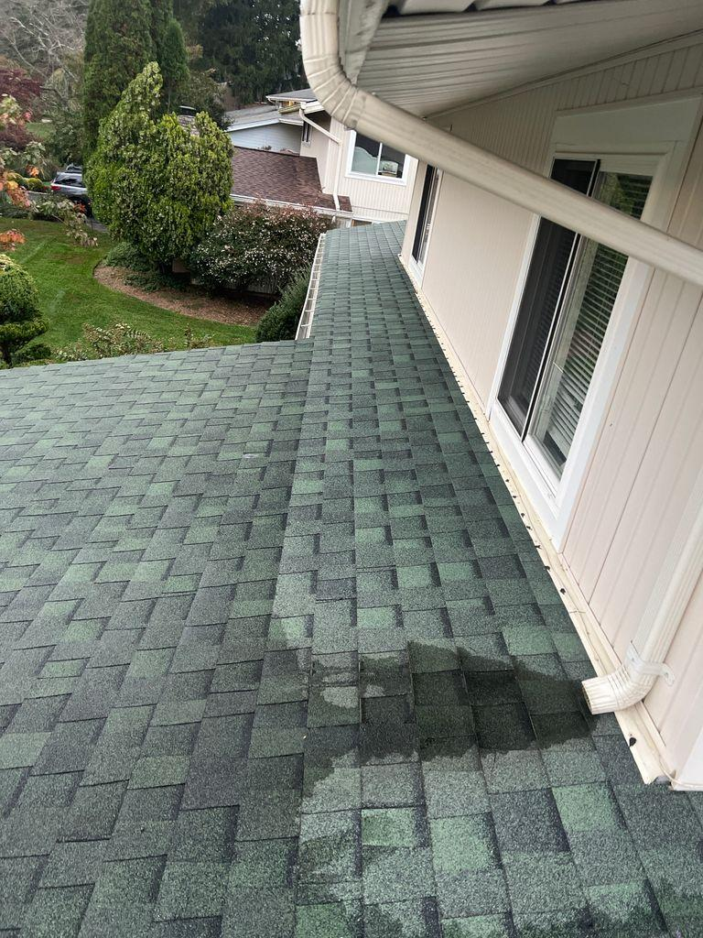
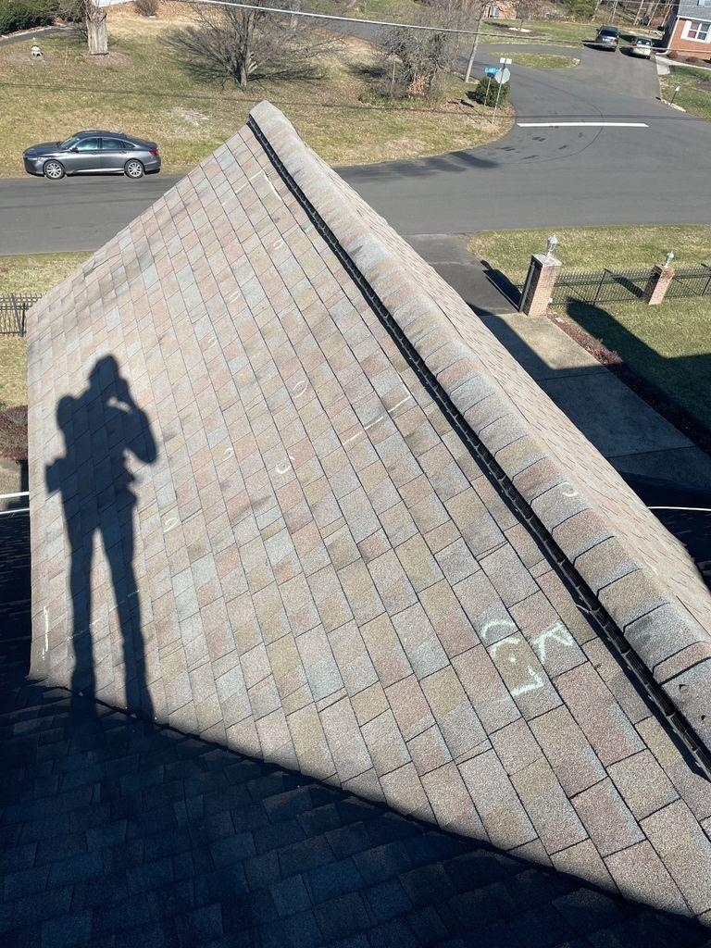
Shingles

Slide 20
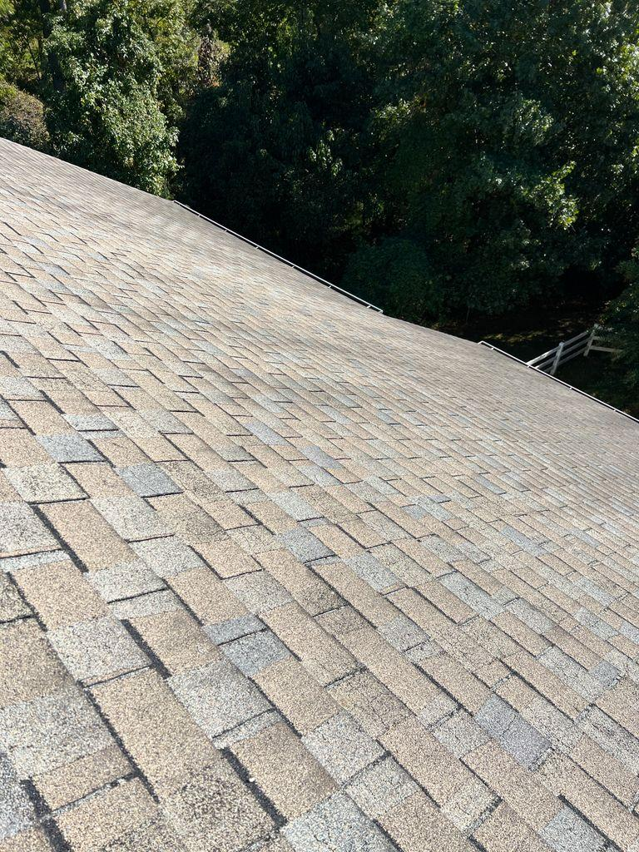
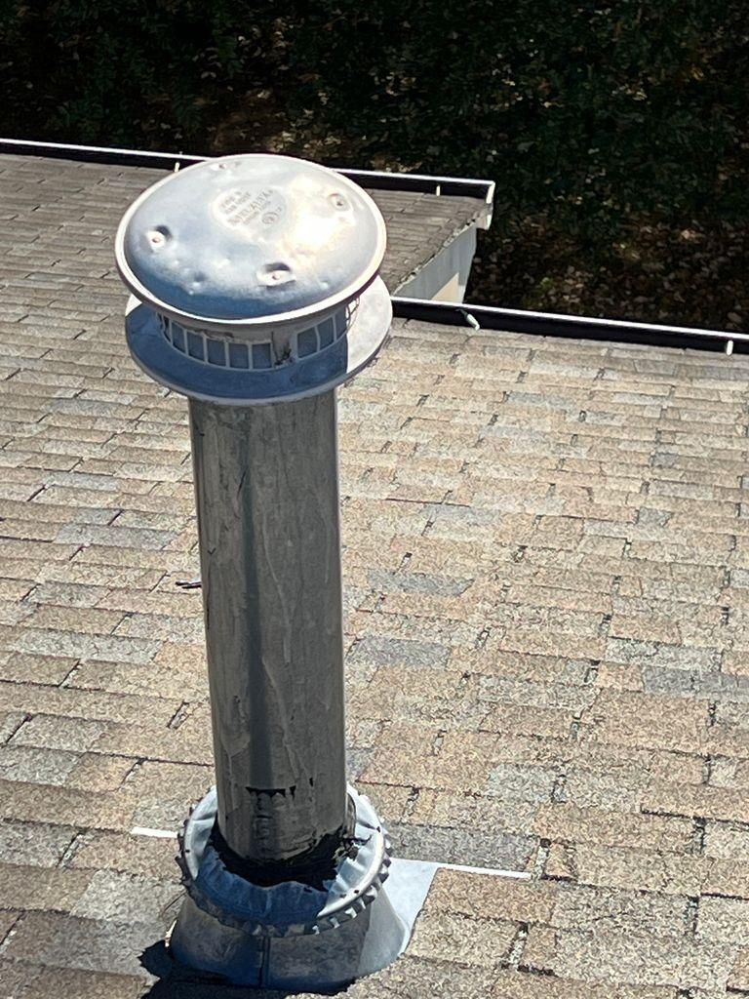
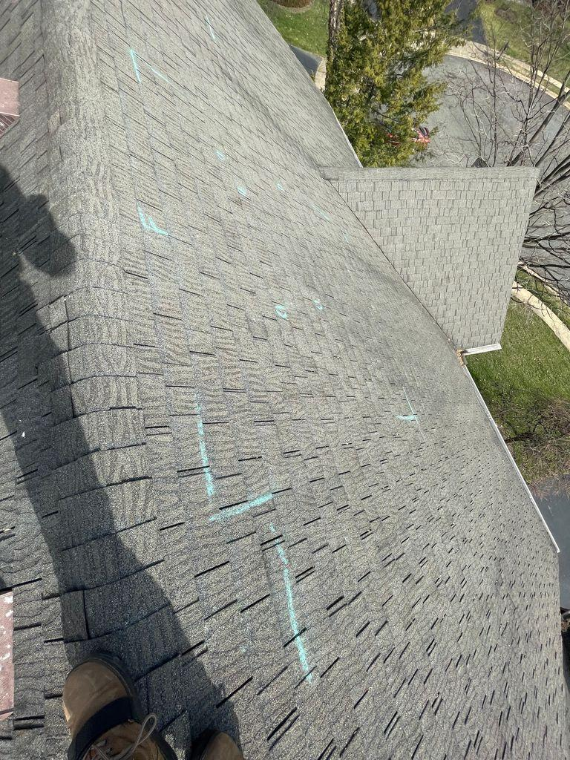
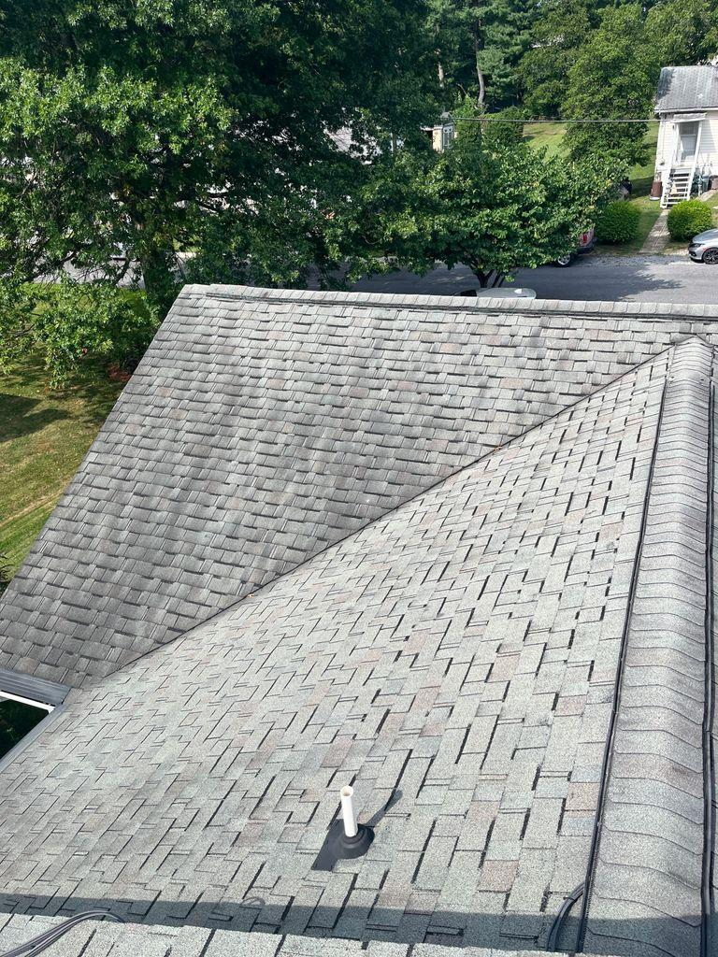
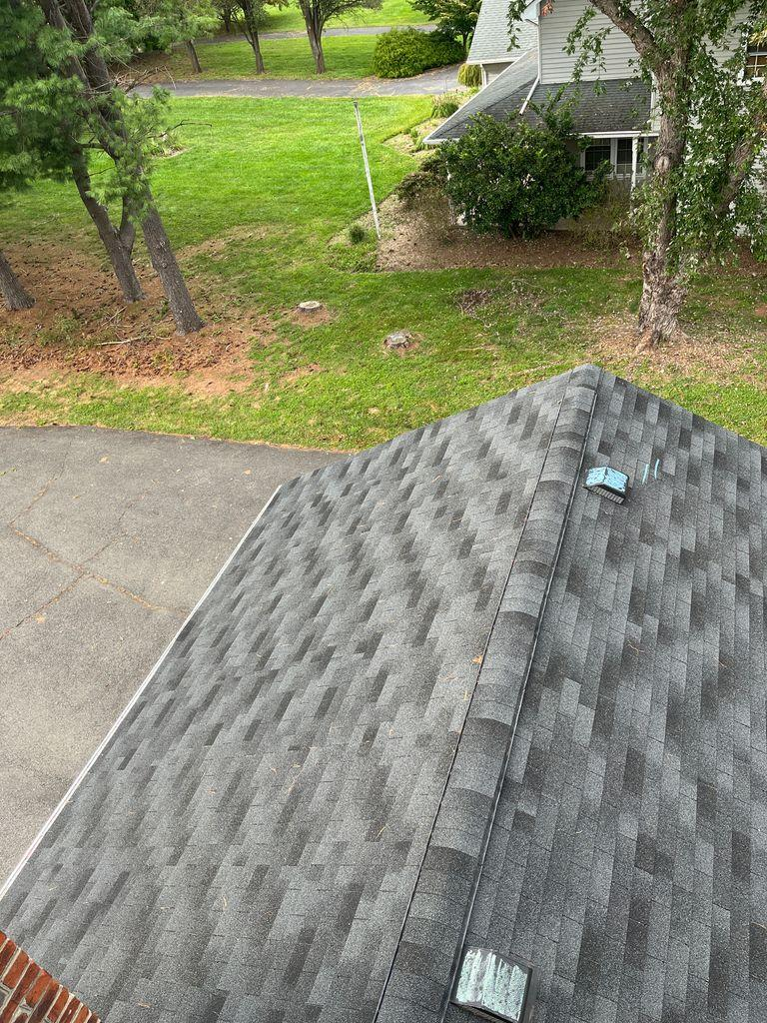
Discontinued Shingles

Slide 21
The Sales Cycle: Generating New Business
KNOCK KNOCK KNOCK
Make it a goal to knock 70 doors minimum per day
Pin the houses
Take good (quick) notes
KNOCK SOME MORE

Slide 22
The Sales Cycle: Inspections
Conduct the inspection in the order of the inspection
Think about safety
If you do not feel safe, DO NOT DO THE INSPECTION
Always ensure ladder is safely placed
Safety items you should consider:
Cougar Paws (Get this before anything else)
Bungee Cords
Pitch Hopper
Other roofing items – reach out to discuss additional safety items

Slide 23
The Sales Cycle: Adjuster Meeting
Adjuster meeting typically happens within 2 – 7 days
You meet with the insurance adjuster
You will also be creating your formal photo report this day
The decision from the insurance company usually comes within 1 – 10 business days
Once a decision is made, they usually only send the estimate to the homeowner
Ensure the homeowner is prepped to send this to you if the insurance company does not send it to you
Don’t worry – we will review this in much more detail later – we just want to ensure you understand the timeline at this point

Slide 24
The Sales Cycle: Project Meeting
After you send the estimate to Amber (estimates@theroofdocs.com) and to me, we will begin to review the estimate and conduct what is called a Project Review
Within a few days, the job will be assigned to one of our Project Coordinators who will schedule a Project Meeting with your homeowner
This typically happens within a week of receiving the estimate
After that meeting, the homeowner will sign the Project Documents and submit Downpayment.
The Downpayment will typically be the first payment the insurance company sends. This payment is called Actual Cash Value (ACV)
You receive $1,000 of the job at Downpayment.

Slide 25
The Sales Cycle: Install and Final Payment
The install will typically be scheduled in 4 – 6 weeks from the time that the Homeowner submits Downpayment
After the install is complete, we will schedule a Quality Check and Wrap Up with the homeowner.
They will sign the Certificate of Completion here and we will submit this to the insurance company
The insurance company will then release the remaining funds. They call this payment Depreciation.
The Homeowner then submits Final Payment. This payment is a combination of the Depreciation plus their insurance deductible.
Once they submit Final Payment, you will receive the remaining 16% of the job.
The first 6 weeks, you get 16% of all completed jobs. After that, you have to qualify to get the max of 16%.

Slide 26
The Sales Cycle: Commission %’s and Bonuses
Insurance Sales
$1000 paid on Downpayment
Townhomes do not count as a sign/up sale unless:
Has aluminum siding
A minimum of 15sqs
March - October
10+ Sign ups: 16%
8 - 9 Sign ups: 10%
Less than 8 Sign ups: 6%
November and February
8+ Sign Ups: 16%
Less than 8 Sign ups: 6%
December and January
4+ Sign ups: 16%
Less than 4 Sign ups: 6%
Retail
Nothing paid on Downpayment
Solar: 2%
Other than Solar: 2%
15 Sign Ups or $250k in Revenue: $2k
20 Sign Ups or $300k in Revenue: $4k
25 Sign Ups or $350k in Revenue: $6k
30 Sign Ups or $400k in Revenue: $10k
35 Sign Ups or $450k in Revenue: $12k
40 Sign Ups or $500k in Revenue: $16k
President’s Club
$2mil Annual Sales -or-
$750k in 3 consecutive months in revenue
There will also be monthly incentives to earn additional bonuses, items (watches, golf clubs, etc), and events.
Rep has the option to receive bonus in first 90 days even if they have a negative draw balance
All bonuses and incentives will be applied towards negative draw balance first

Slide 27
1099 + Workers Comp
1099 Tips
Workers Comp requirement

Slide 28
Recap
Please have Generic Initial Pitch completely memorized
Please always be safe when conducting inspections
Sales Cycle: 9 – 16 weeks from sign up
Work towards those bonuses! How? KNOCK KNOCK KNOCK
Be familiar with the different type of shingles
Please setup/submit Worker’s Comp to me
I will then send you Gusto (direct deposit) email
Please be here at 1000am tomorrow and ready to start
TRAFFIC
Please wear your Roof ER shirt and comfortable and durable shoes/pants for roof inspections
Have a great evening!

Slide 29
Roof-ER Sales Training
Welcome:
Prepare a quick introduction for the sales meeting today.
What industry are you coming from?
What are you looking forward to working at Roof-ER?

Slide 30
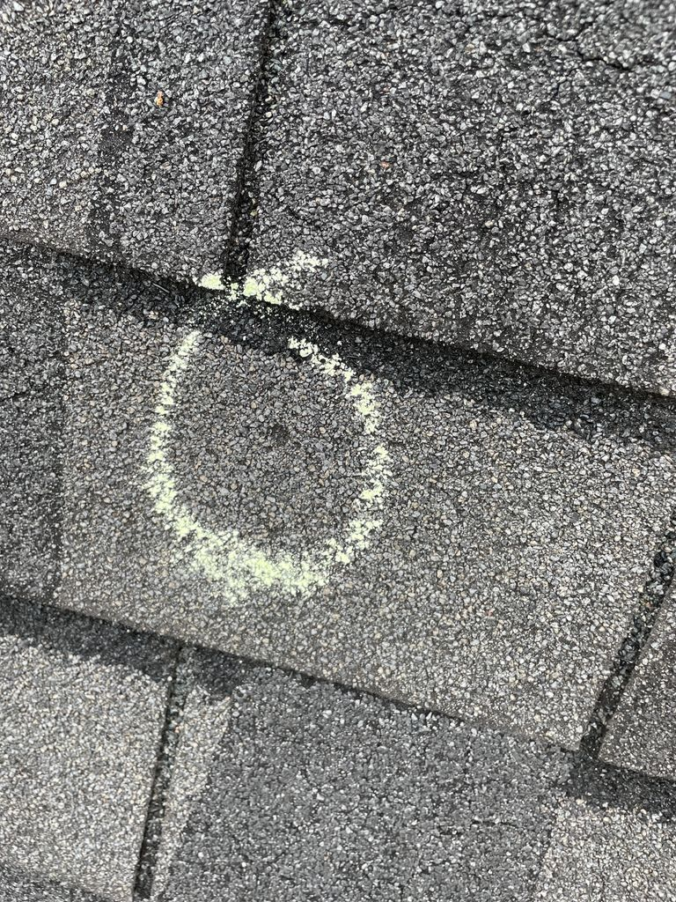
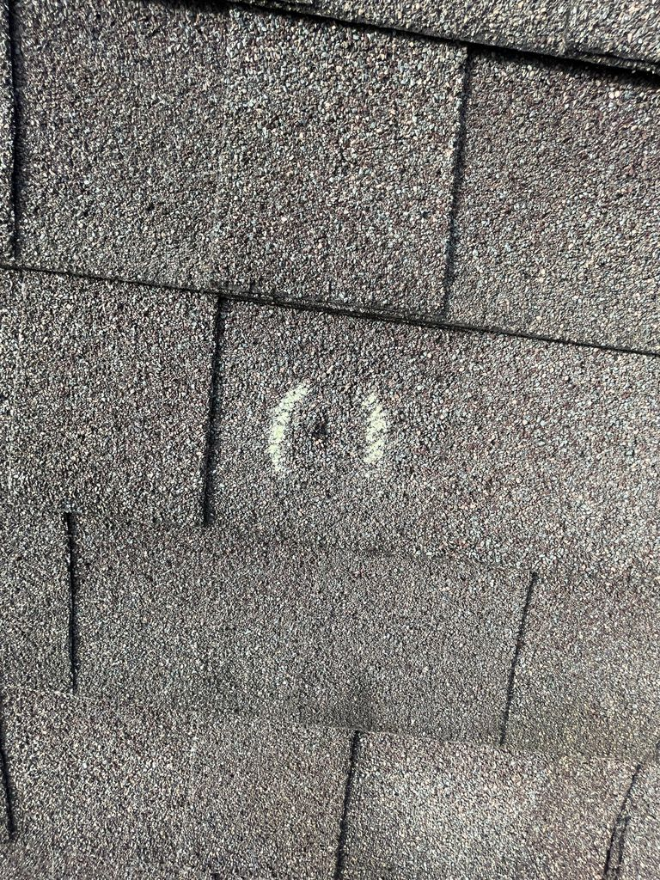
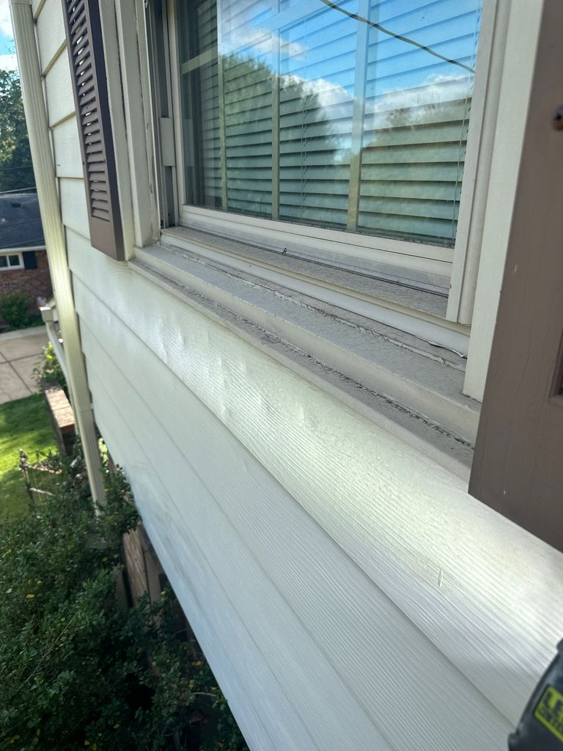
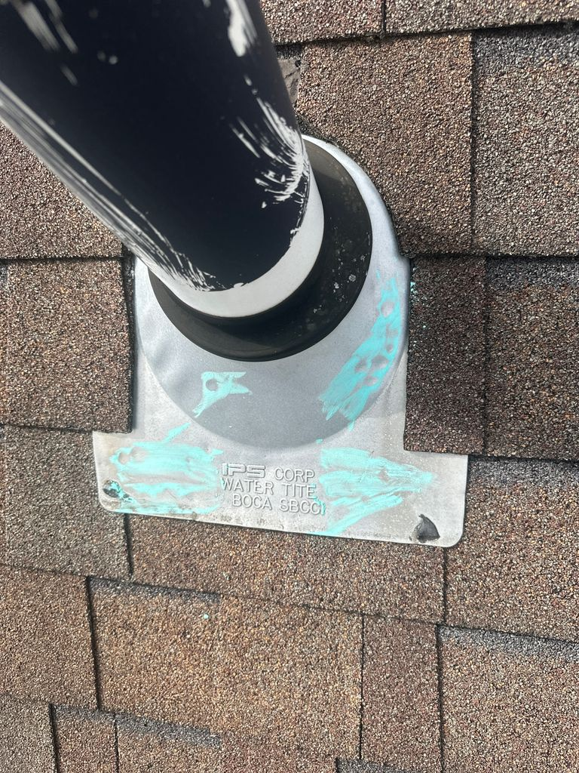
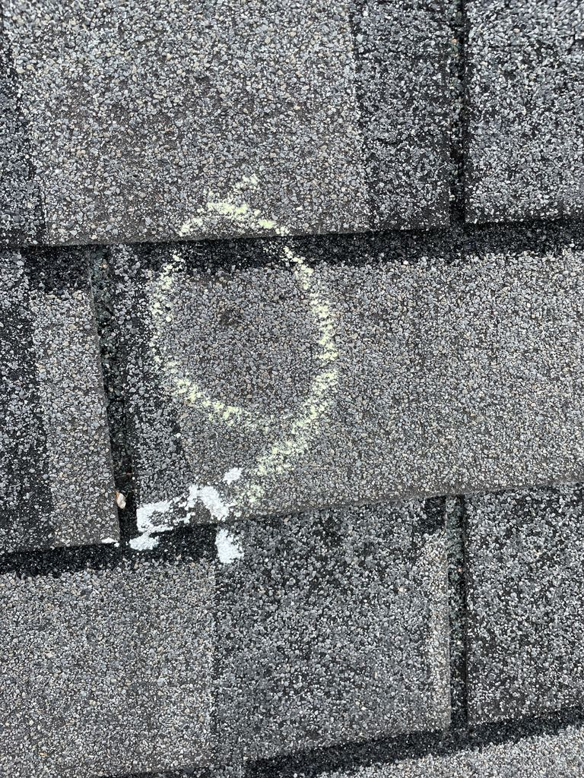
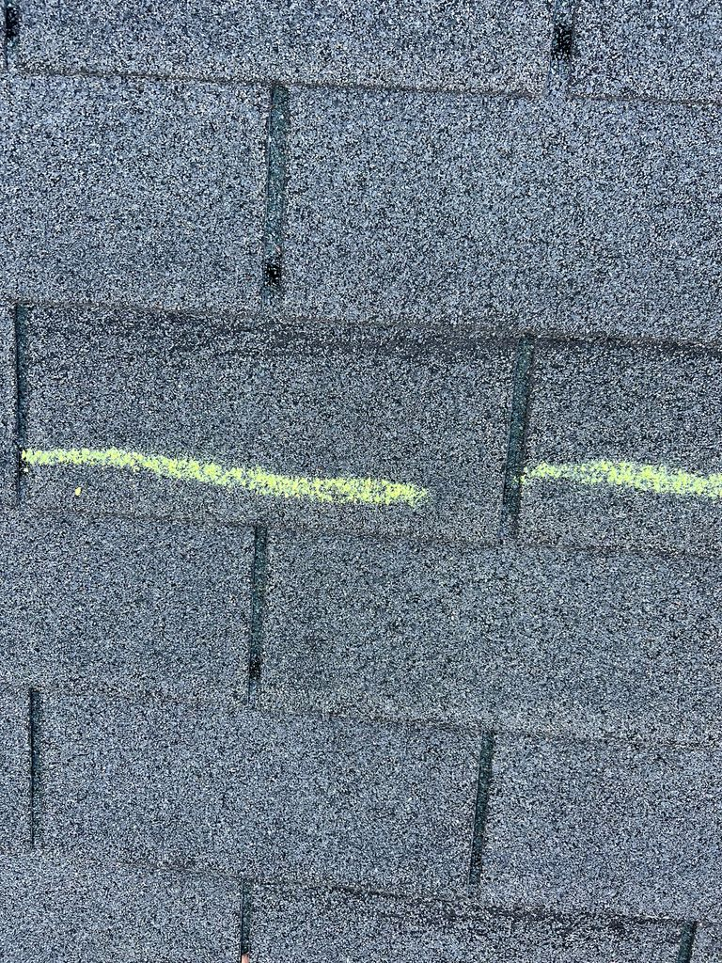
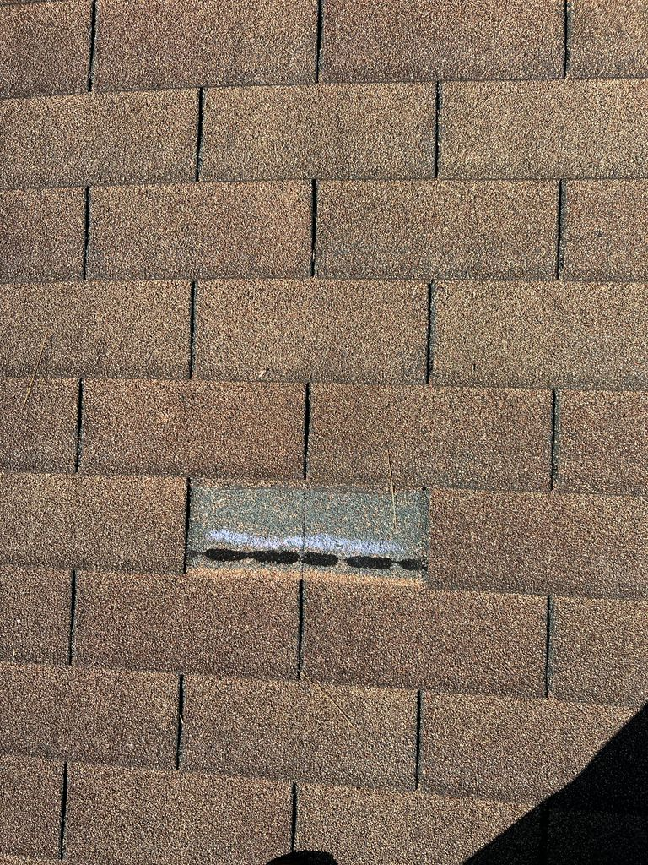
Storm Damage

Slide 31
Google Drive

Slide 32
Inspection
Mailbox/House Number
Overview of House
Front Elevation Collateral
Damage to screens, gutters, downspouts, siding
Right Elevation Collateral
Damage to screens, gutters, downspouts, siding
Rear Elevation Collateral
Damage to screens, gutters, downspouts, siding
Left Elevation Collateral
Damage to screens, gutters, downspouts, siding
Roof Overview Collateral
Damage to roof metals and other collateral on the roof
Circle Hail Hits & Slash Wind Damage (close up of each)
Overview of majority of the damage chalked up
Pictures of granules in the gutters or at the bottom of downspouts
Entire inspection shouldn’t take any longer than 15-20 minutes. How thorough of an inspection you should do is a judgment call. Getting enough photos to sell the homeowner is most important. It doesn’t matter how quickly you are able to complete the inspection if you don’t have enough damage-photos for the homeowner to be on board with filing the claim.
Flashlight

Slide 33
Post-Inspection Pitch
Knock on the door
“Hey _______, so I have a bunch of photos to show you. First I walked around the perimeter of the house to look for collateral damage. I’ll also show you the collateral damage we found on the roof.” Say this while going through house number and overview photos
Start showing the pictures of damage to screens, gutters, downspouts, and soft metals
“While this damage functionally isn’t a big deal, it really helps build a story. Think of us like lawyers and this collateral damage is the evidence that builds the case which helps us get the roof approved.”
Continue to slide through collateral damage photos

Slide 34
Post-Inspection Pitch
“Here are the photos of the damage to your shingles. Anything I have circled means its hail damage
Remain on a photo of hail damage as you explain the following
“This is exactly what we look for when we're looking for hail damage. If you notice, the divot is circular in nature. Even if this damage doesn’t look like a big deal, what happens over time, these hail divots fill with water, freeze…., when water freezes it expands and breaks apart the shingle which will eventually lead to leaks. That is why your insurance company is responsible and your policy covers this type of damage.”
Start slowly swiping through all the pictures of hail.
“As you can see there is quite a bit of damage.
Start slowly swiping through all the pictures of hail.

Slide 35
Post-Inspection Pitch
Now show them pictures of the granules in gutters and downspouts
“As you can see here, granules have filled up your gutters. These granules are supposed to be what’s protecting your home. When wind and hail hits your roof, it knocks out these granules which reduces the lifespan of your roof.”
Put phone away
“This is very similar to damage to ________’s home and/or the rest of the approvals we’ve gotten in the area”.

Slide 36
Post-Inspection Pitch
“With that being said, insurance companies are always looking for ways to mitigate their losses. It’s unfortunate but that’s how they make money. The most important part of this process is that when your insurance company comes out to run their inspection, we are here as storm experts to make sure you as a homeowner get a fair shake. If they are missing anything we make sure they see all the damage that I just showed you.”
“What I’m going to do now is run to my car, grab my iPad and we can get this process started”! Go get iPad
As you approach back to the house/homeowner ask “Is there a place we could sit down for 5-10 Minutes”?
Once you are in the house, spend some time building rapport as you get settled.

Slide 37
Post-Inspection Pitch
“Okay, so first I am going to grab some of your basic information for our system. Then we can let your insurance company know about the damage”.
Gather information from the homeowner:
Full name
Address
Phone Number
E-mail
Insurance Company
“Do you happen to know your deductible? If not, no big deal at all”!
After you have collected all the information:
Ask if they have the app or if they have the login to the website.
If not, use the Homeowner Information Sheet to prep the HO. As you are writing or typing the information for the HO to use on the call, explain each part to them.
As much as possible, use HO’s phone to make the call
Reference Claim Filing Information Sheet
Move on to Contingency & Claim Authorization

Slide 38
Post-Inspection Pitch: Additional lines if wind damage is present
“Here are the photos of the damage to your shingles. Anything I have circled means its hail damage and anything I have slashed means its wind damage.”
After you go through the lines explaining the hail damage, say:
“Now here are the wind damaged shingles. You have (both,) shingles that are creased from the wind lifting them up (and shingles that have completely been blown off.”)
Show the pictures of wind damaged and/or missing shingles

Slide 39
Post Inspection Pitch
Break into groups
Read through Post Inspection Pitch with Hail Damage a few times
WHEN IN DOUBT, SIGN IT UP. Not every roof is going to look like it was destroyed by 4 inch hail. But, we still find a lot of success here.

Slide 40
Inspection and Post-Inspection Quiz
What are the first pictures you take when you are on the roof?
You should ask if they have the insurance company’s app or website login first – True or False?
We should be mainly focusing on Wind Only claims – Ture or False?
What symbol do we use to mark hail damage?
What symbol is used to mark wind damage?
What are 2 methods you can use to see hail damage to metals better?
You should take all photos of hail damage first (so that they are grouped,) and then all photos of wind damage after – True or False?

Slide 41
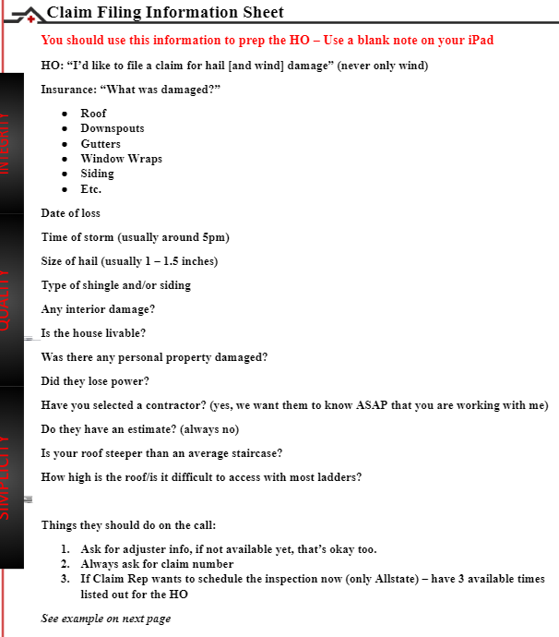
Claim Filing Information Sheet

Slide 42
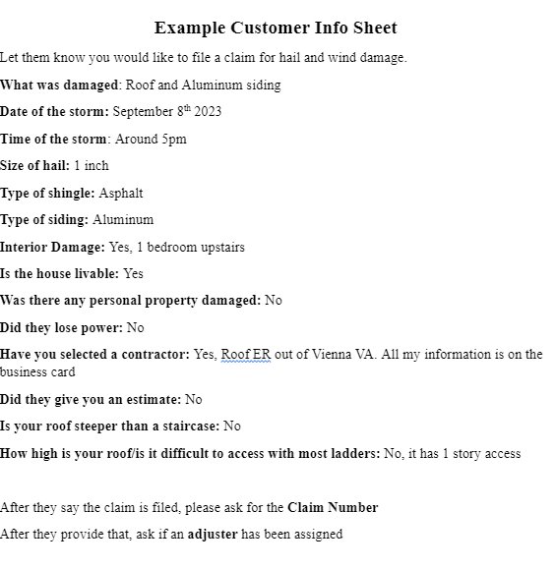
Claim Filing Information Sheet

Slide 43
Calling the Insurance Company
Examples
I will demonstrate a few examples
Connect with your trainers on how to assist your clients with filing this claim

Slide 44
Putting the script together
Go through Initial Pitch without script
Go straight to Inspection and Post-Inspection pitch while reading script

Slide 45
Recap
Familiarize yourself with Storm Damage
Memorize the order of the Inspection
Have Initial Pitch (non-storm environment) and (Hail Only) Post-Inspection Pitch memorized
Familiarize yourself with Claim Filing Information Sheet
Always ask Homeowner if they have the website login or app to file the claim first
Please be in and ready to start tomorrow morning at 1000am

Slide 46
Roof-ER Sales Training
Welcome:

Slide 47
Initial Pitch and Post-Inspection Pitch
Review together

Slide 48
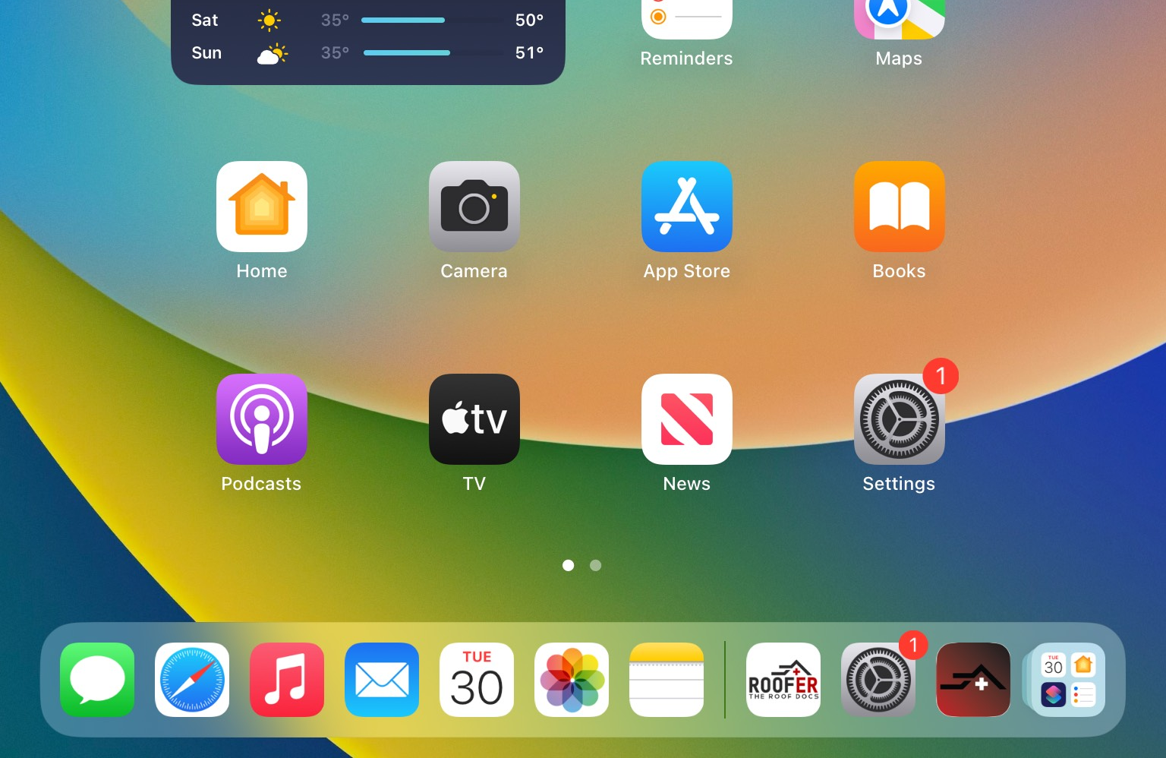
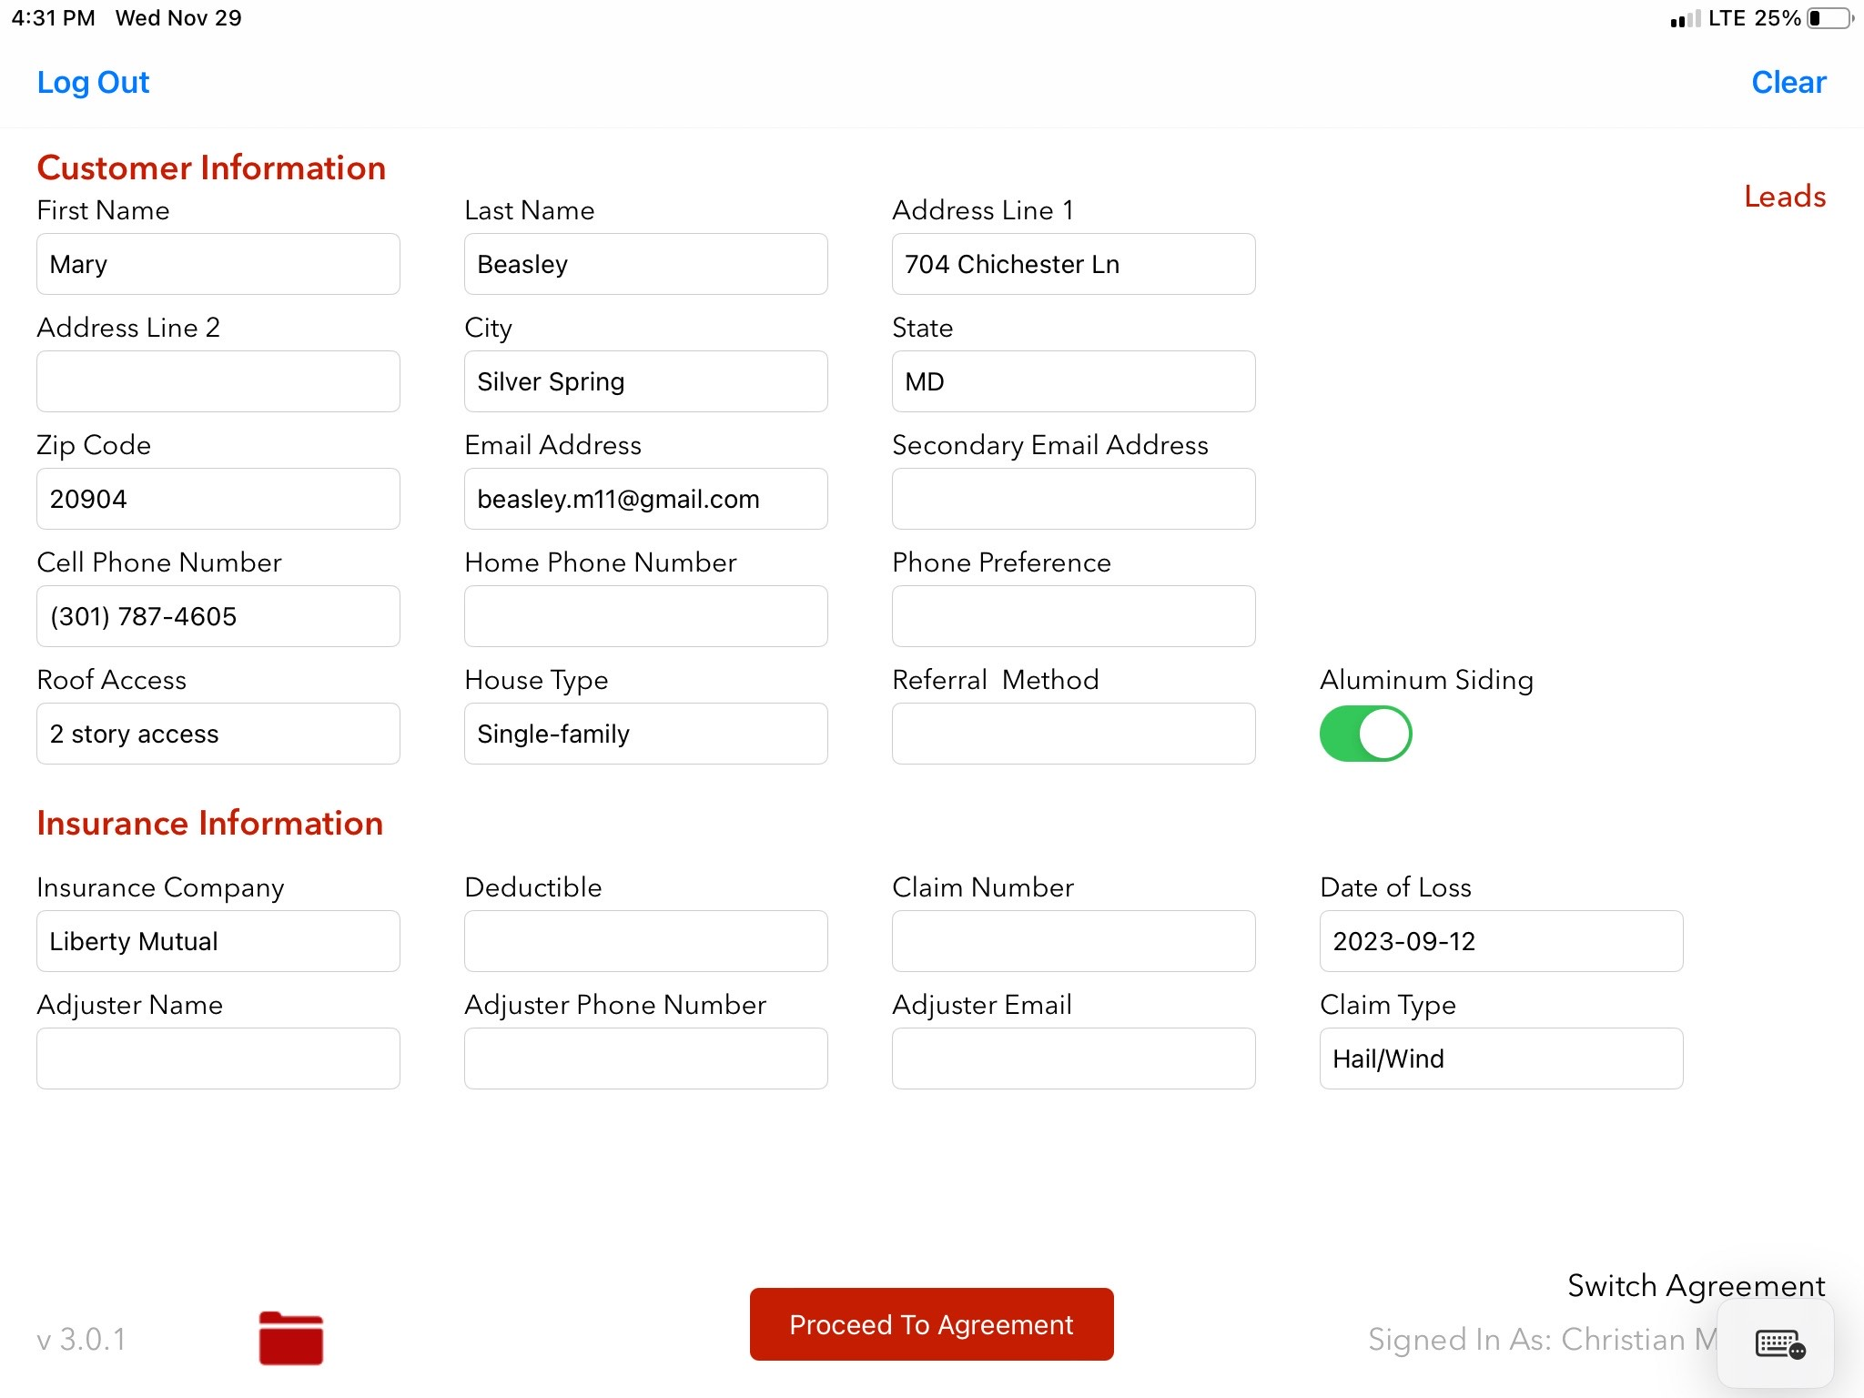
Sales App (Only on your iPad)

Slide 49
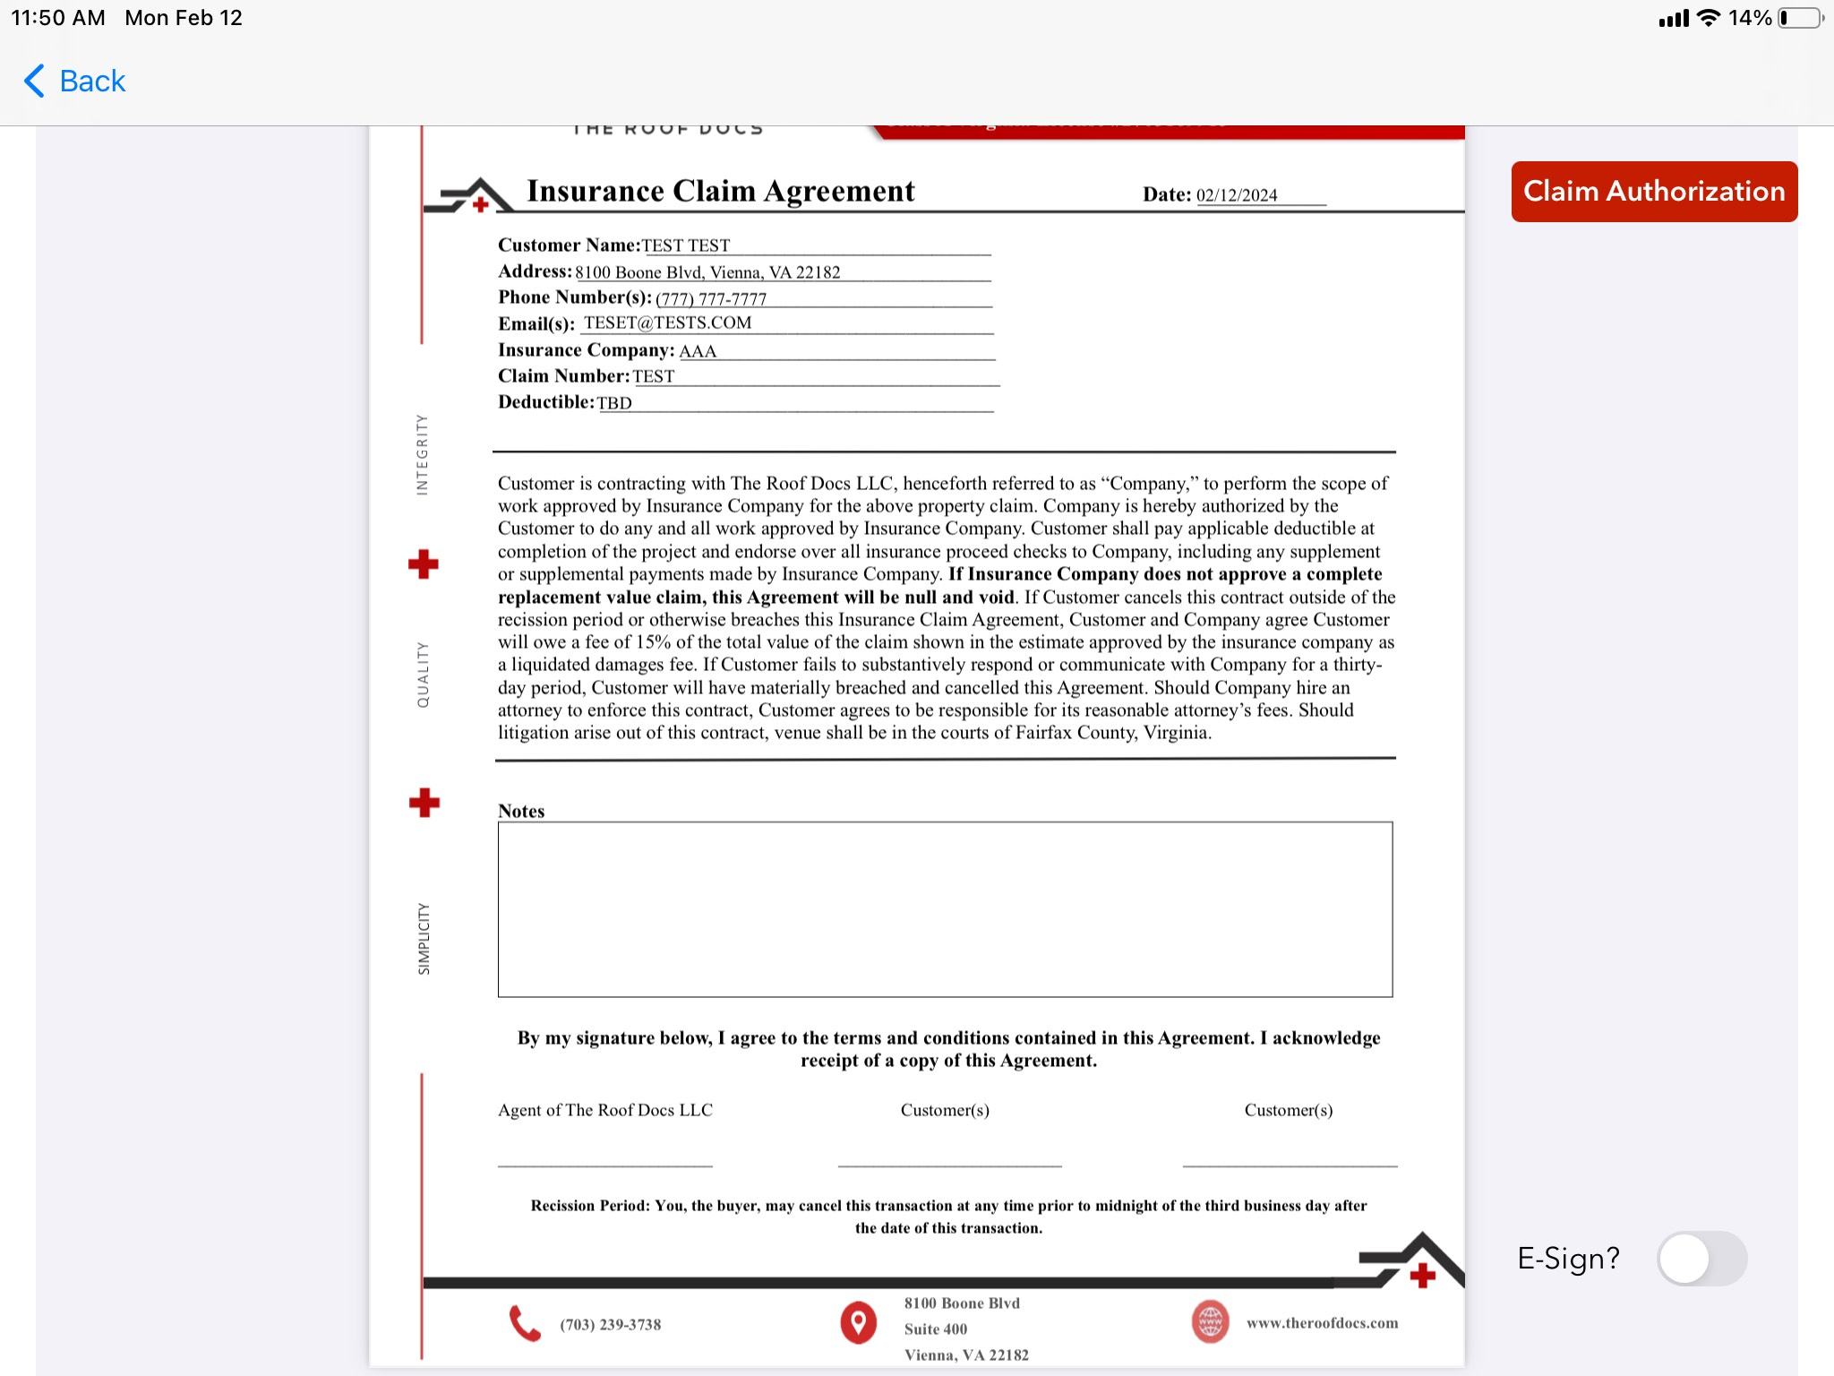
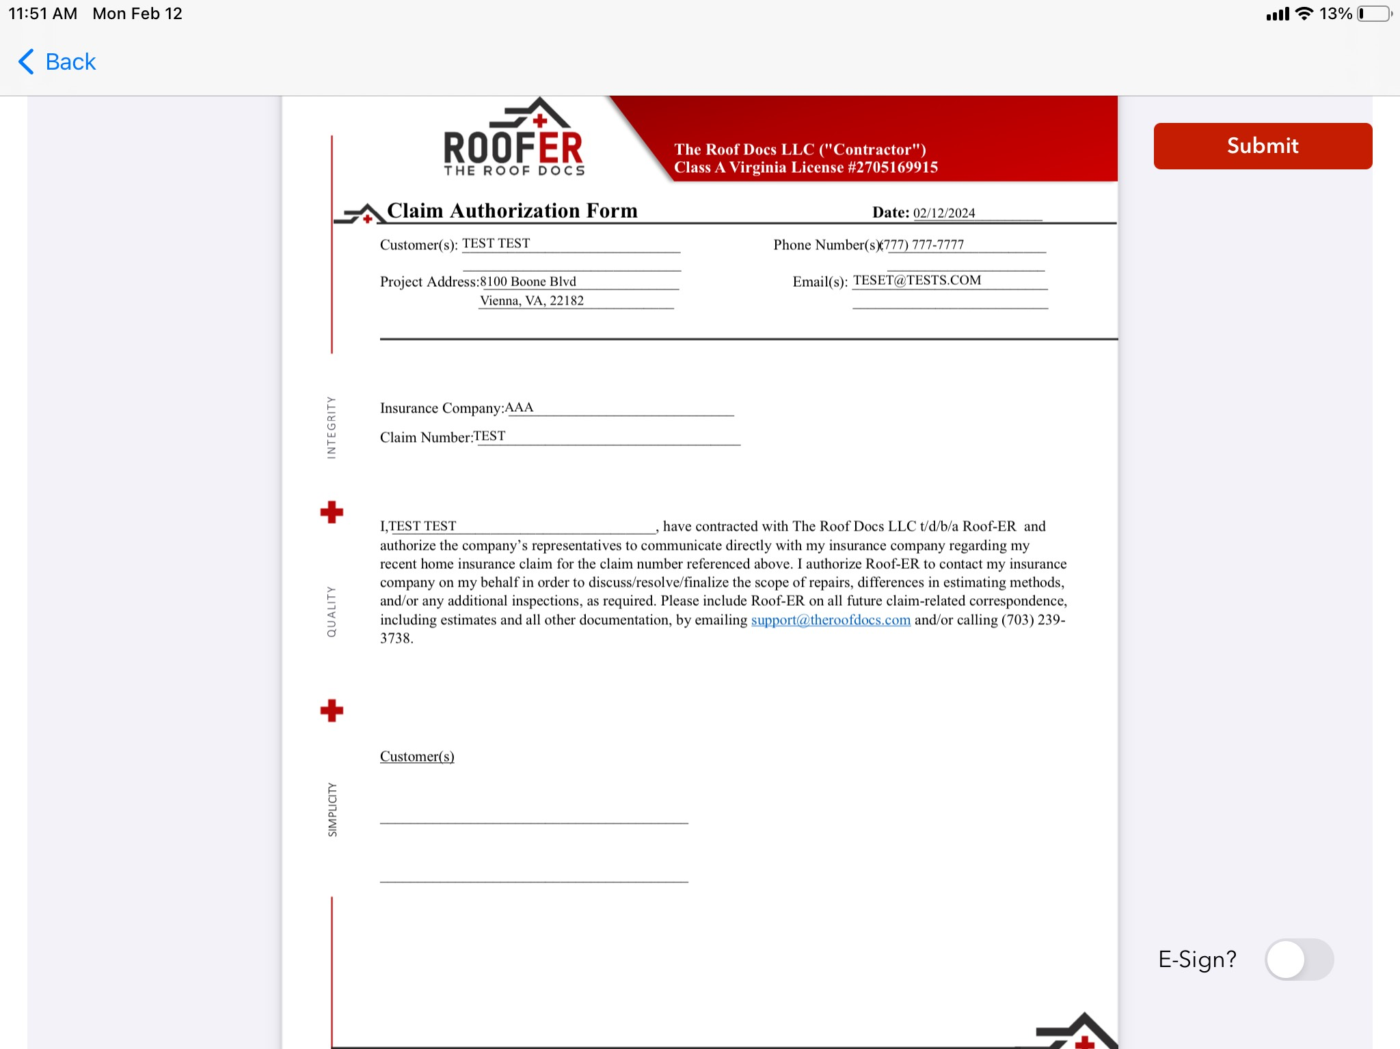
Contingency and Claim Authorization

Slide 50
Google Drive

Slide 51
Contingency & Claim Authorization Script
This is where you really go for the close
After filing the claim: “Okay, perfect! Like they said, an adjuster will be reaching out to you in the next 24 to 48 hours to schedule the inspection. The absolute most important part of this process is that I am at this inspection. Insurance companies don’t want to pay out. They are trying to mitigate their losses after storms. I am there as your representation to make sure you get a fair shake.”
Turn the iPad so you and the homeowner can see.

Slide 52
Contingency & Claim Authorization Script
“This basic/simple agreement backs you as the homeowner by guaranteeing you that your only cost will be your deductible if we get you fully approved. If it is a partial approval or denial, first we will fight and jump through the necessary hoops to turn that into a full approval; but if we are not able to get you fully approved, this contract is null and void and you do not owe us a penny.
“What’s in it for us, is we just want to get to do the work. This agreement commits you to using us if we hold up our end of the bargain and achieve a full-approval.”
You sign
They sign

Slide 53
Contingency & Claim Authorization Script
“This next form is our Claim Authorization form. Very simple, it allows us to communicate with your insurance company. I’ll be here for the inspection and we will also communicate with them through email and phone calls so you don’t have to be a middle-man. Of course, I’ll always keep you looped in with our communication by CCing you in all emails and updating you on any conversations we have.”
They sign
Press Submit enter password “roofer” if it asks.

Slide 54
Contingency & Claim Authorization Script
“Alright, we are all set! Again, the most important part of this process is that I am here when the insurance company comes out. Ideally you can have them call me to schedule that directly. If they call me, great! But, regardless, please get the adjuster’s information (name, email, phone number) and send that over to me so that I can communicate with them before the inspection. If they insist on scheduling with you, go ahead and pencil in a time and avoid these times and days [provide your schedule]
Answer any questions that the HO may have
“Thank you, sir/ma’am, looking forward to seeing you on the day of inspection, you have my contact information on my card if you need anything else.”

Slide 55
Contingency and Claim Authorization

Slide 56
GroupMe
Be active in the GroupMe!
Post your Sign Ups on GroupMe – this is how they are tracked
Always start with “Sign Up:”
Format: Sign up / Storm Damage Item 1 / Storm Damage Item 2 / Storm Damage Item etc. / Insurance Company / Customer Last Name
Example: Sign up / Roof / Siding / Gutters / DS / Allstate / Francis

Slide 57
Adjuster Meeting Scheduling
The Insurance Company will schedule the Adjuster Meeting after you assist the Homeowner in filing the claim
Try to take control of this (Homeowner must be present if there is interior damage)
You have the ability to reach out to the Adjuster to try and get this rescheduled with the Homeowner’s understanding
As much as possible, avoid Tuesday mornings for Adjuster Meetings, as we have our Weekly Sales Meetings
ASK YOUR TRAINER IF THEY HAVE AN ADJUSTER MEETING YOU CAN ATTEND WITH THEM

Slide 58
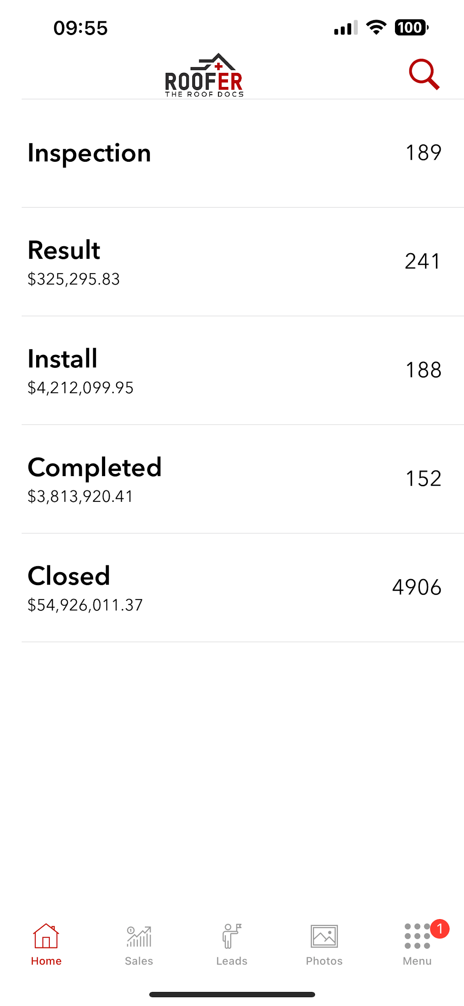
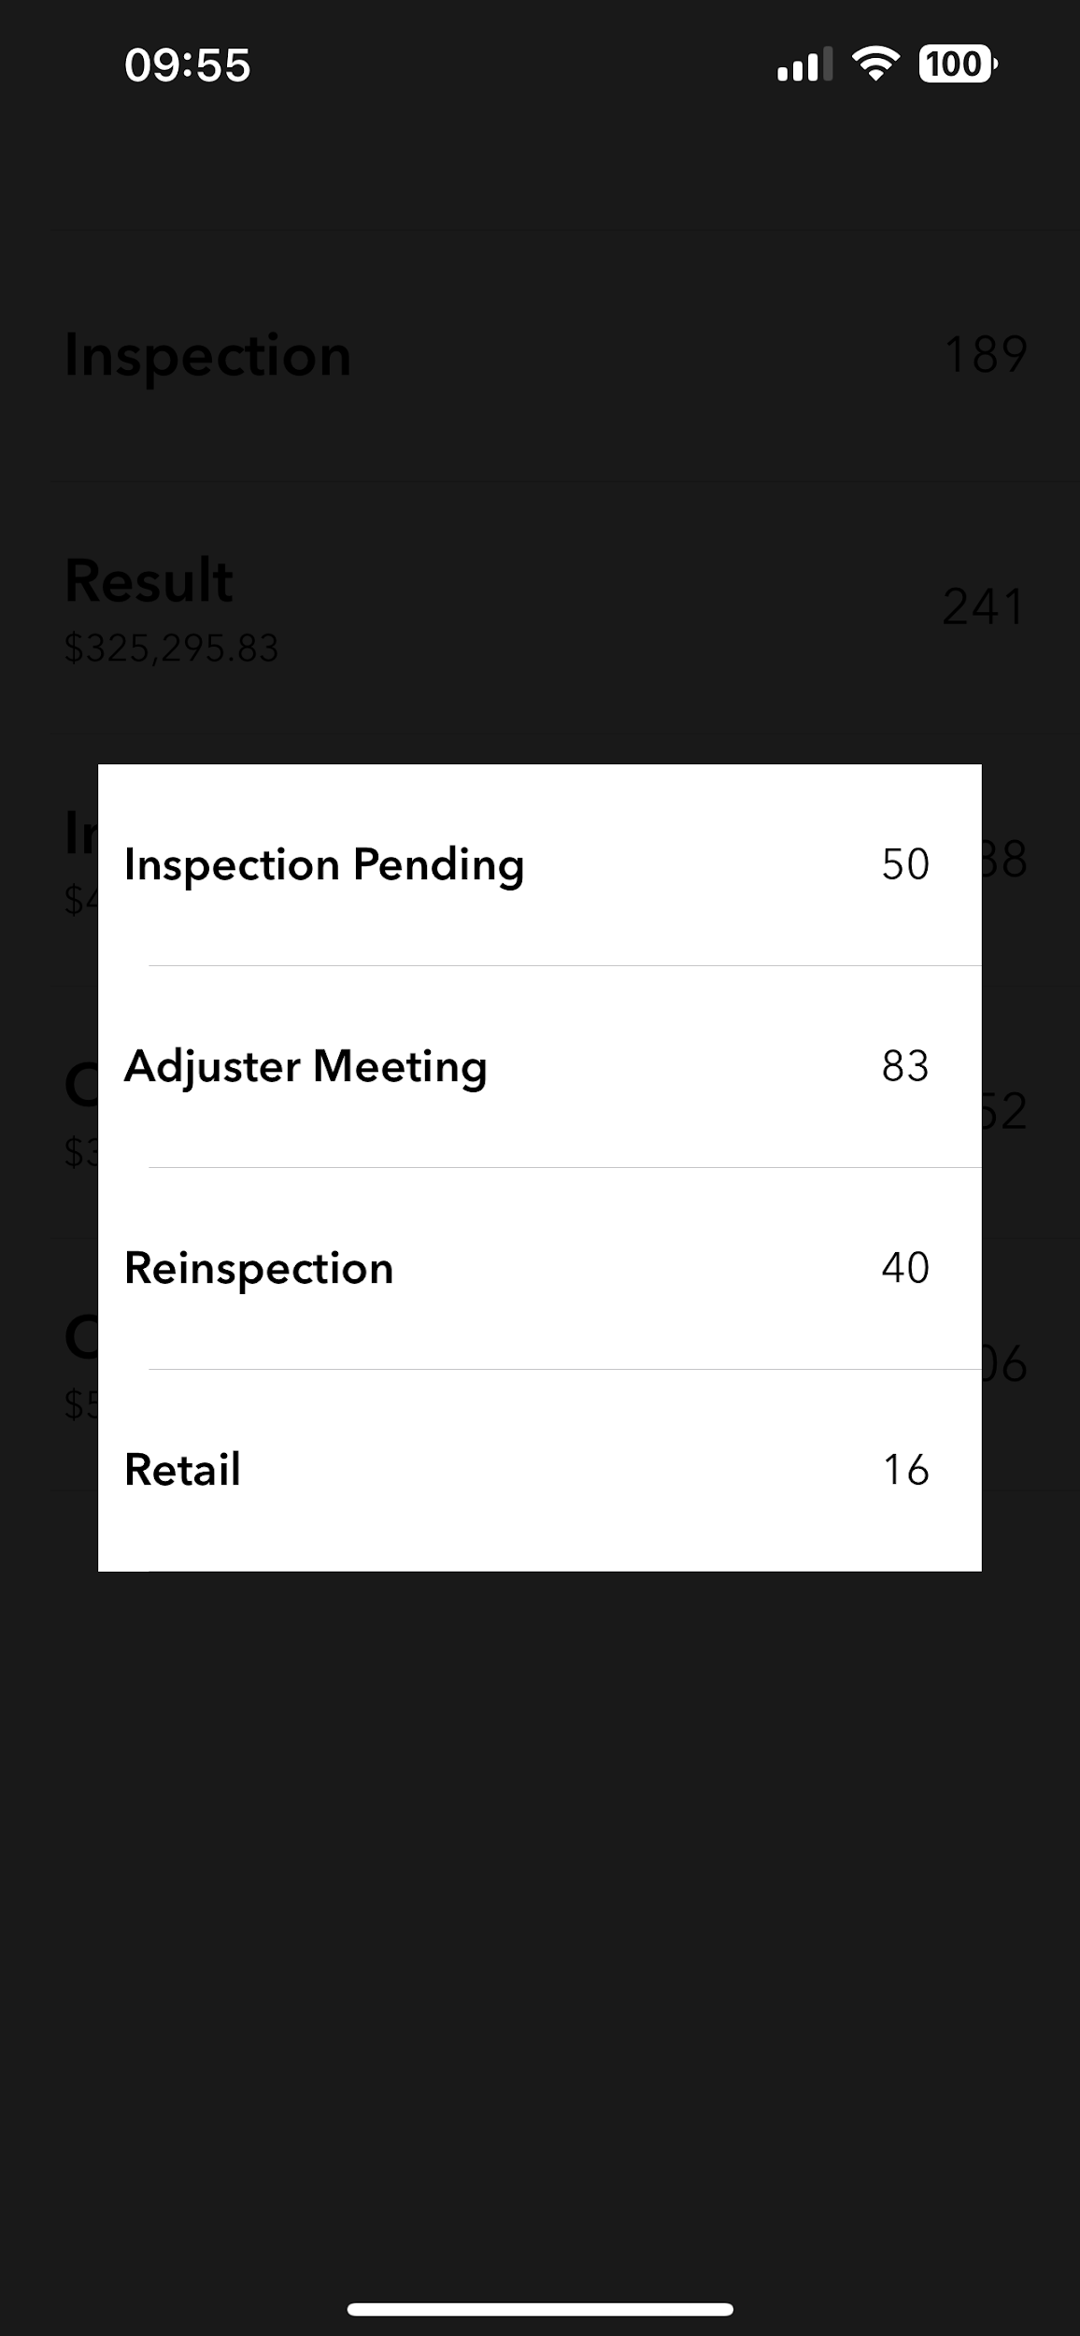
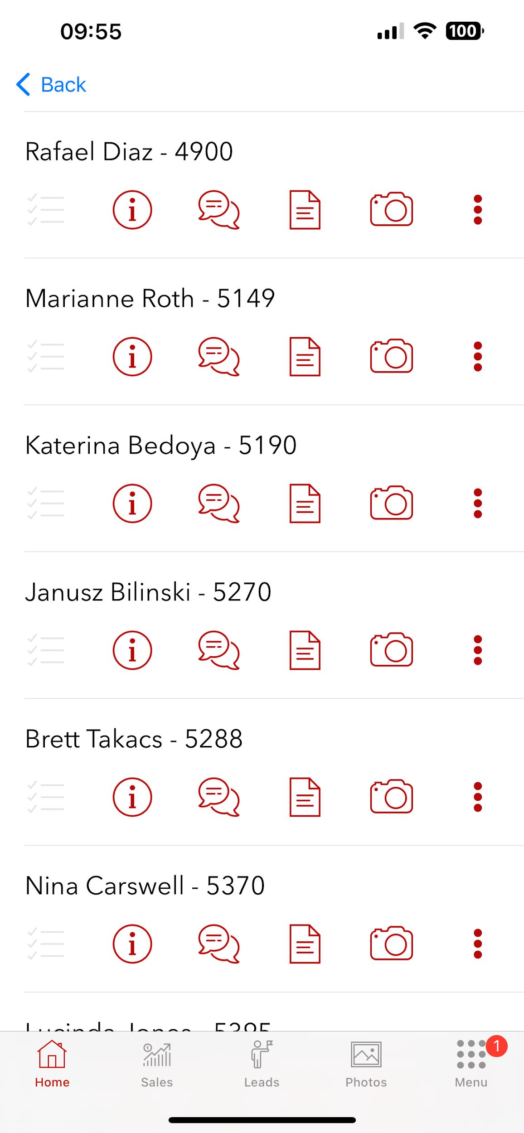
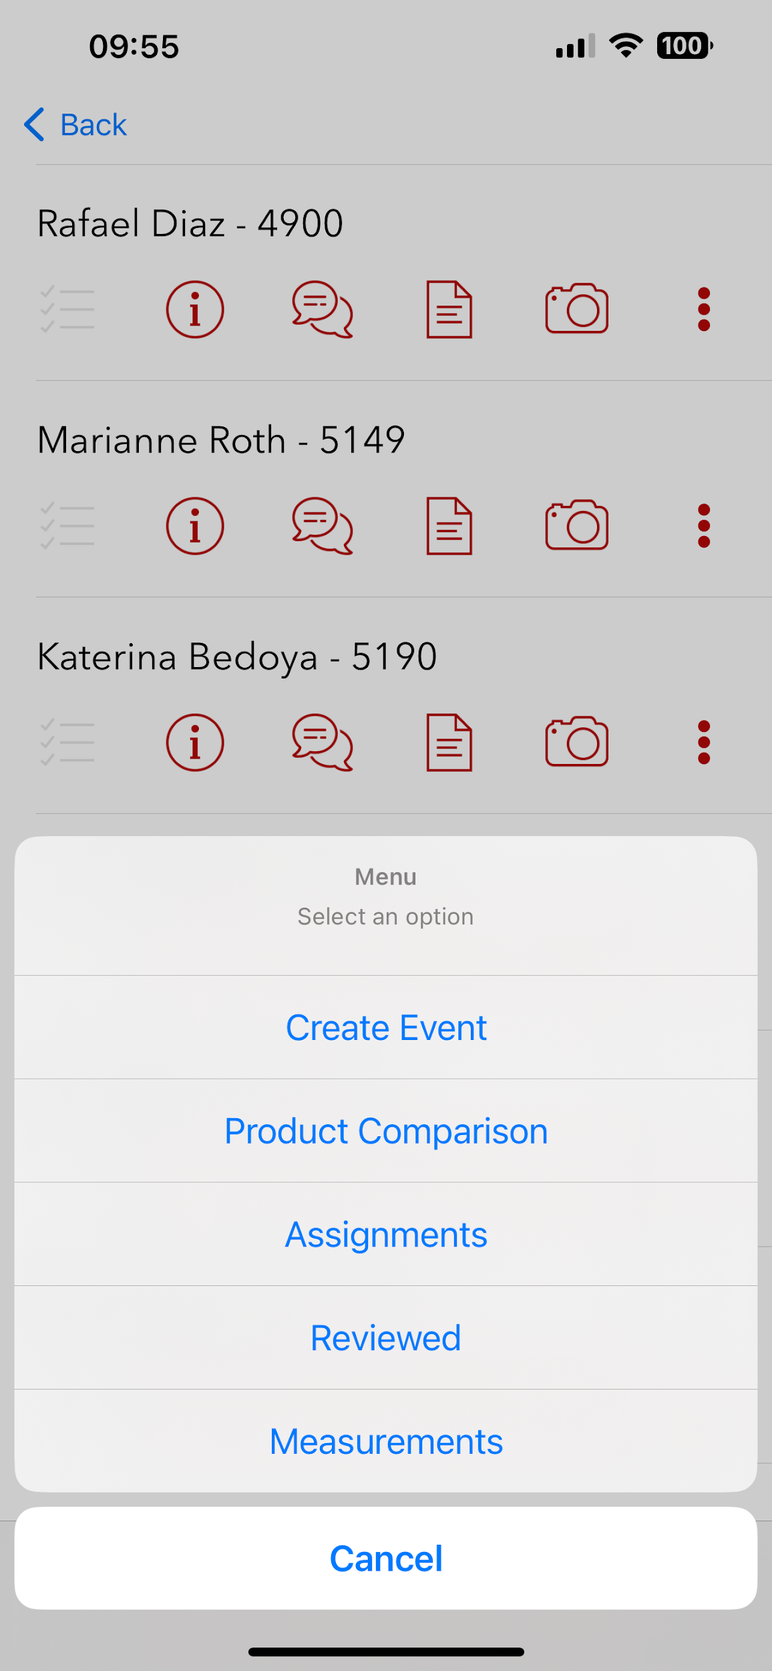
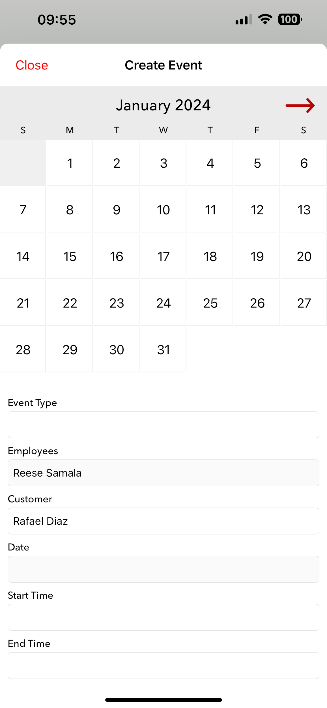
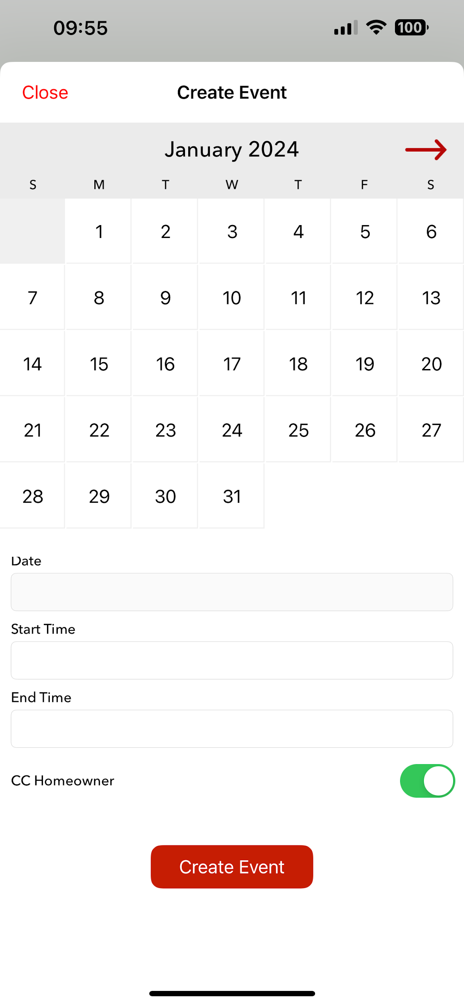
Scheduling Adjuster Meetings in the Field Portal App

Slide 59
Contingency & Claim Authorization Script
Break into groups
Read through Contingency & Claim Authorization Script a few times

Slide 60
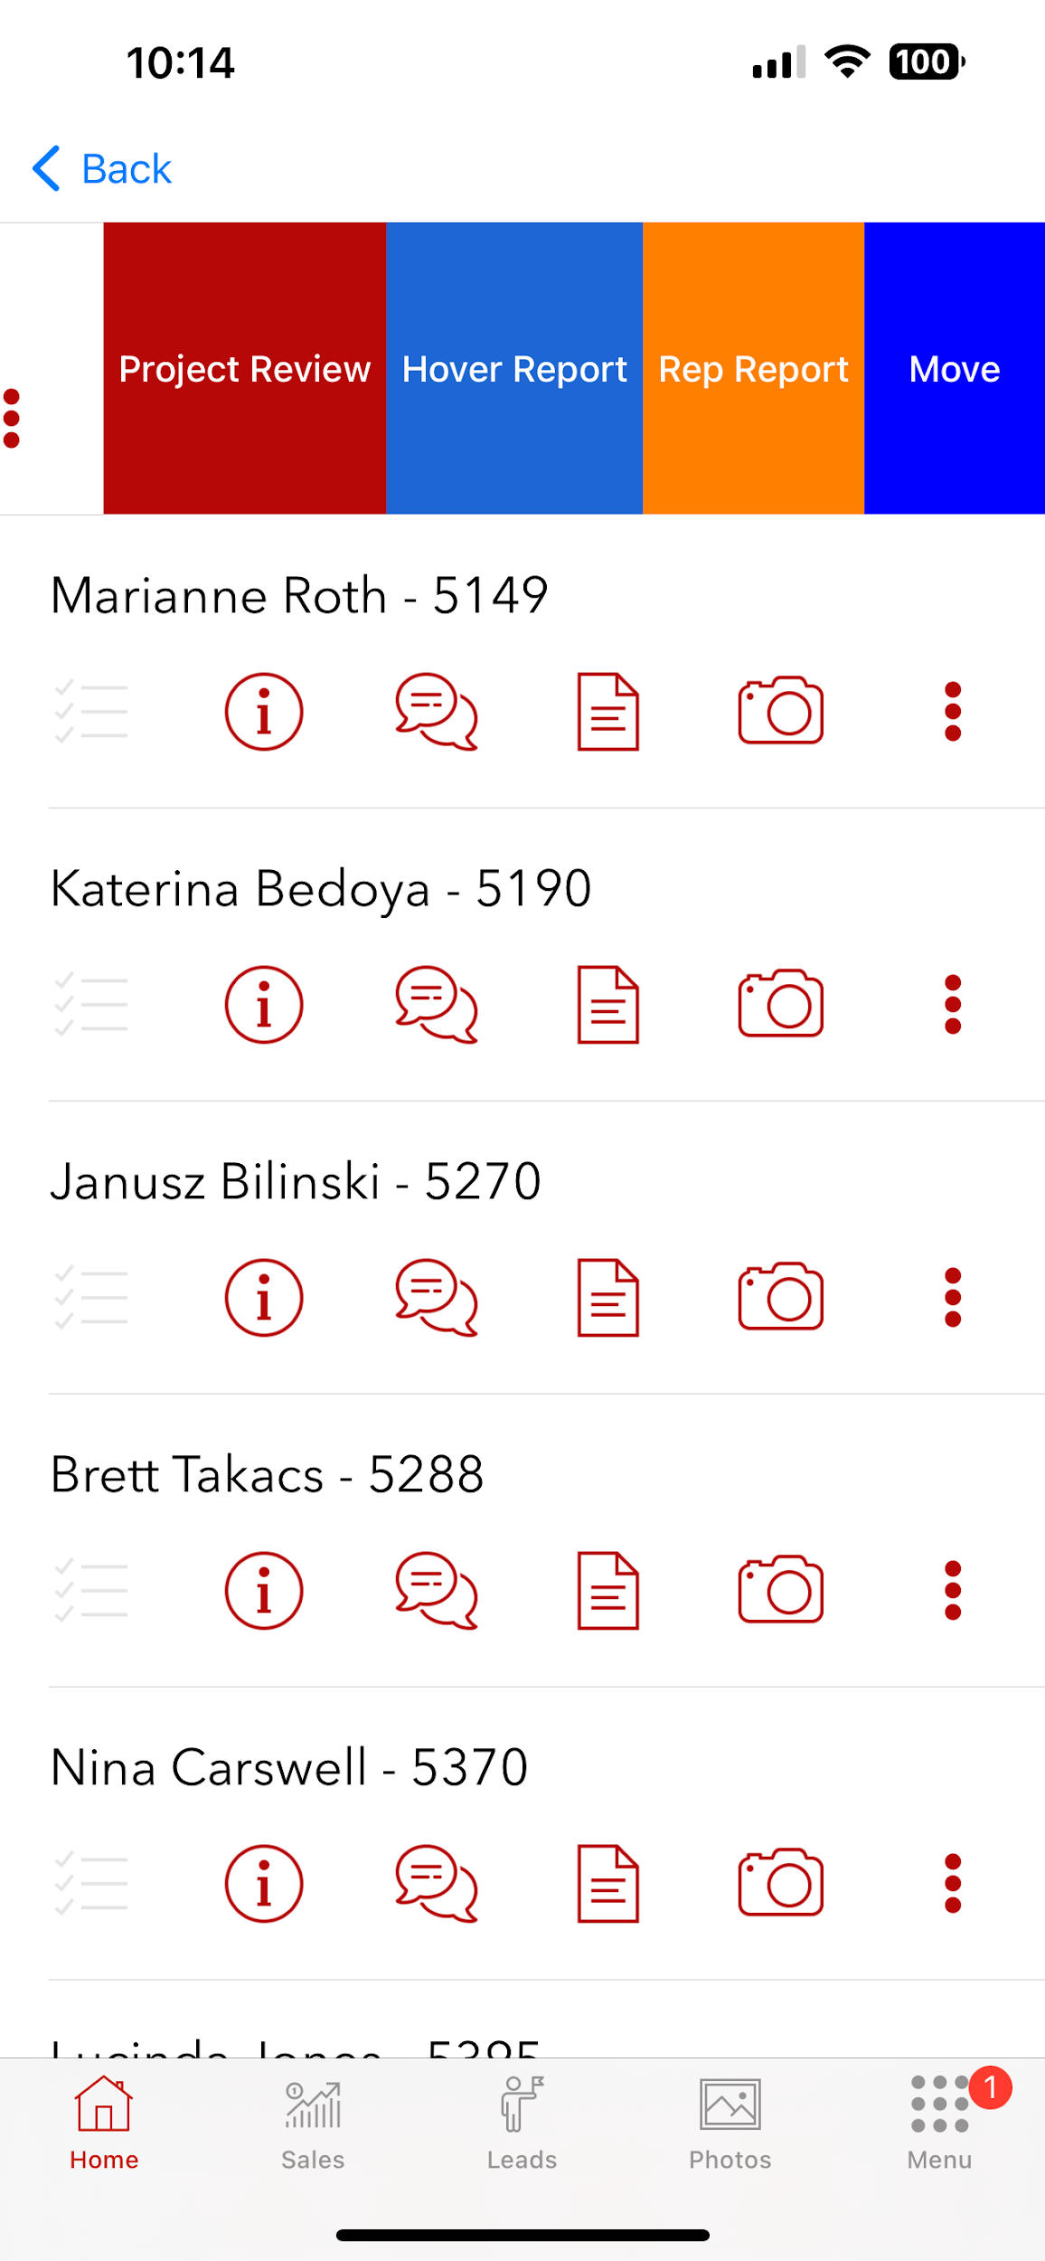
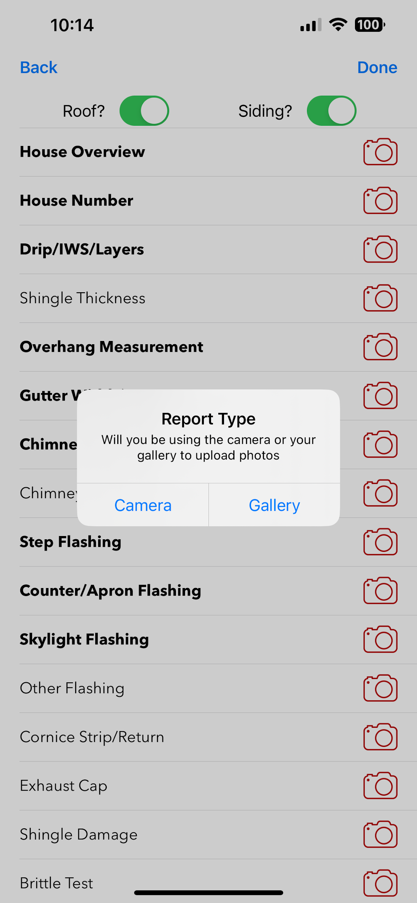
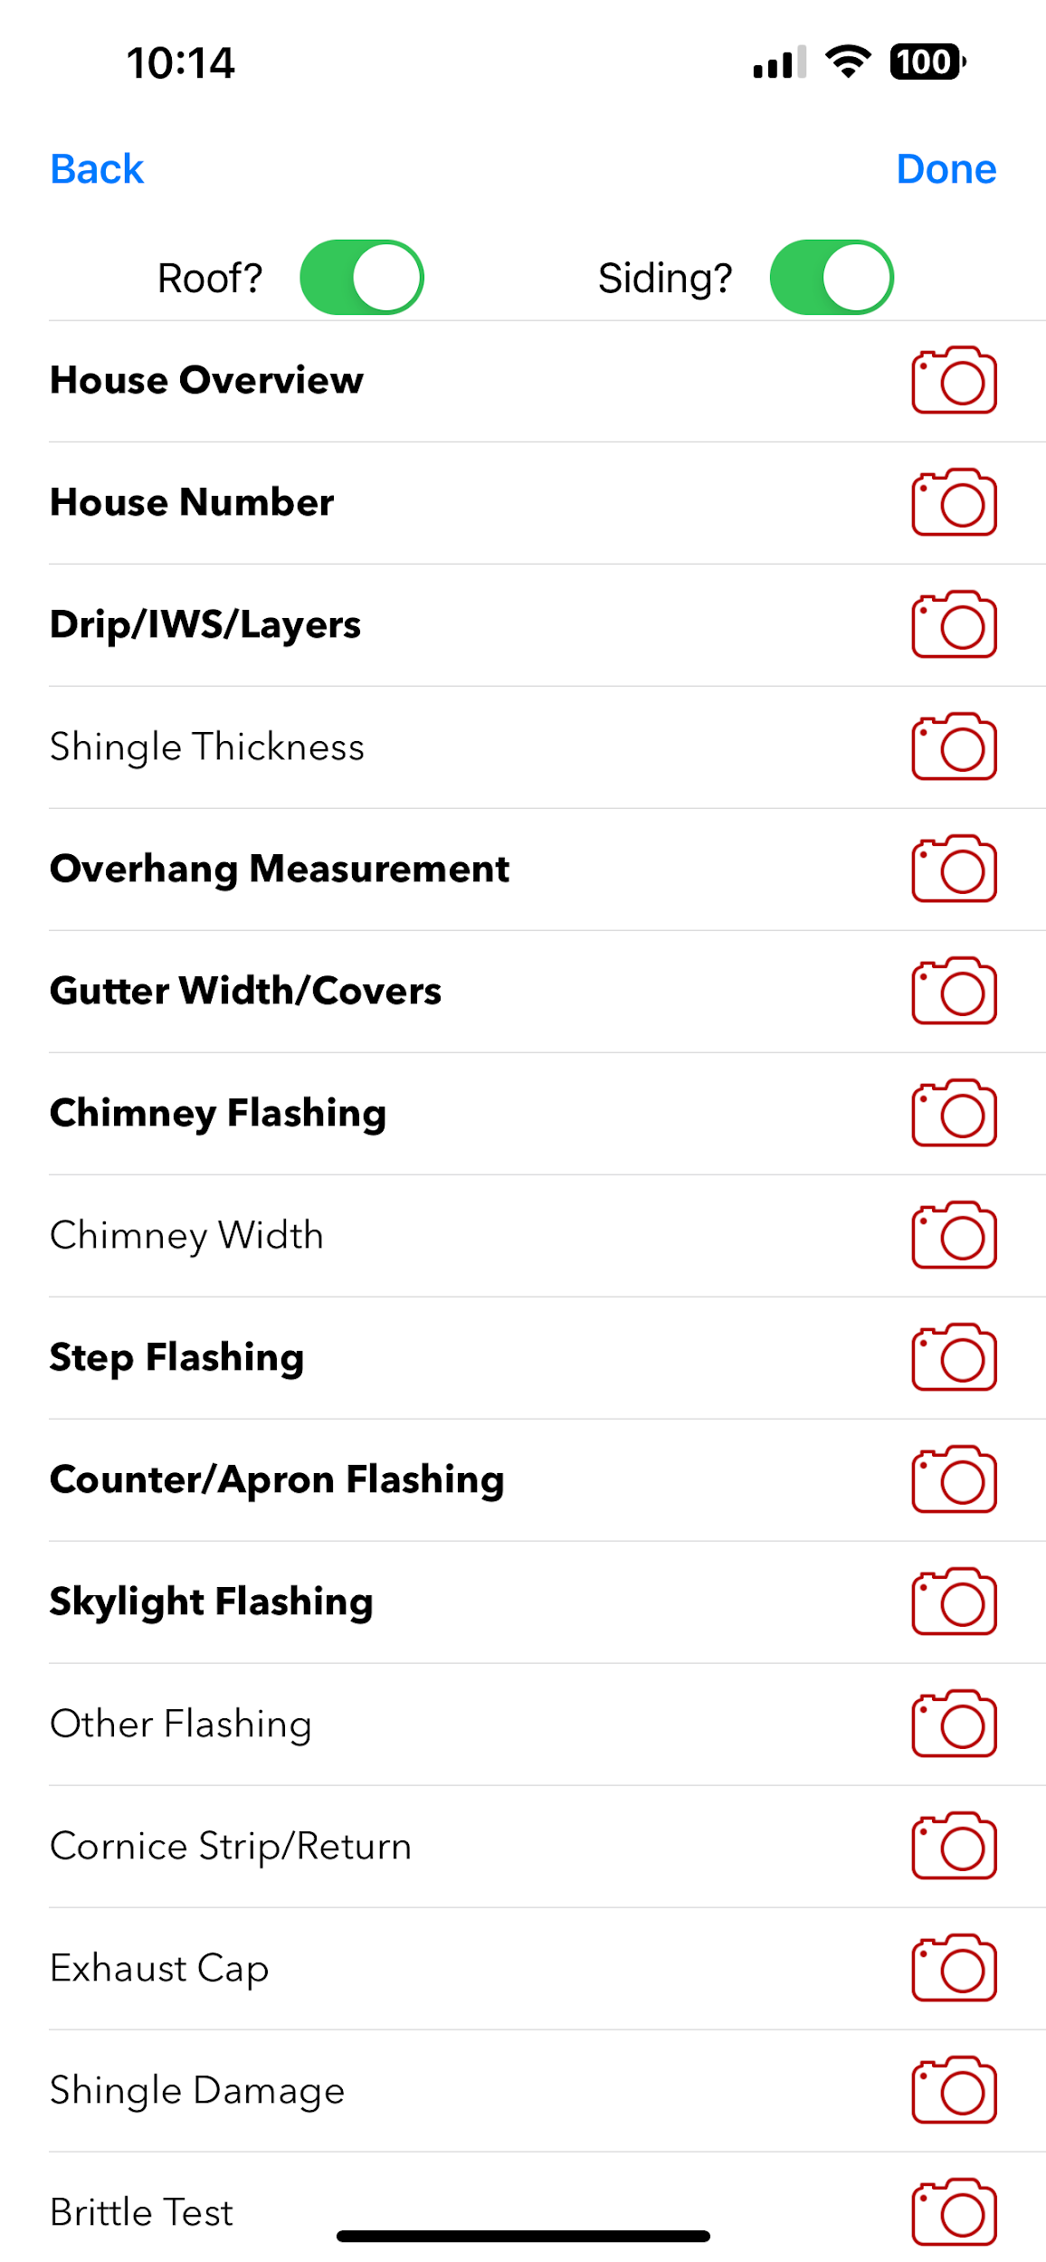
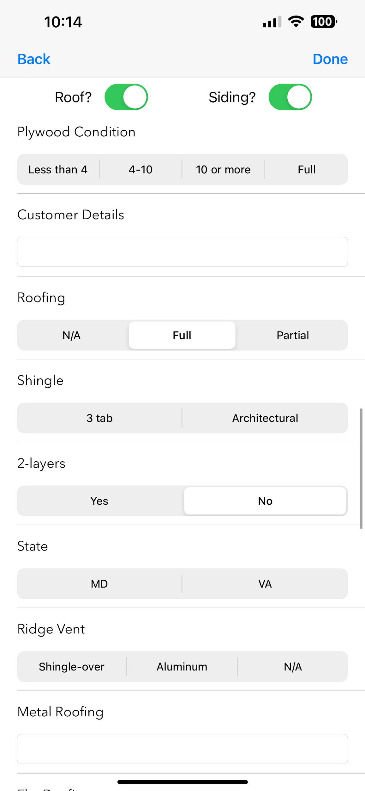
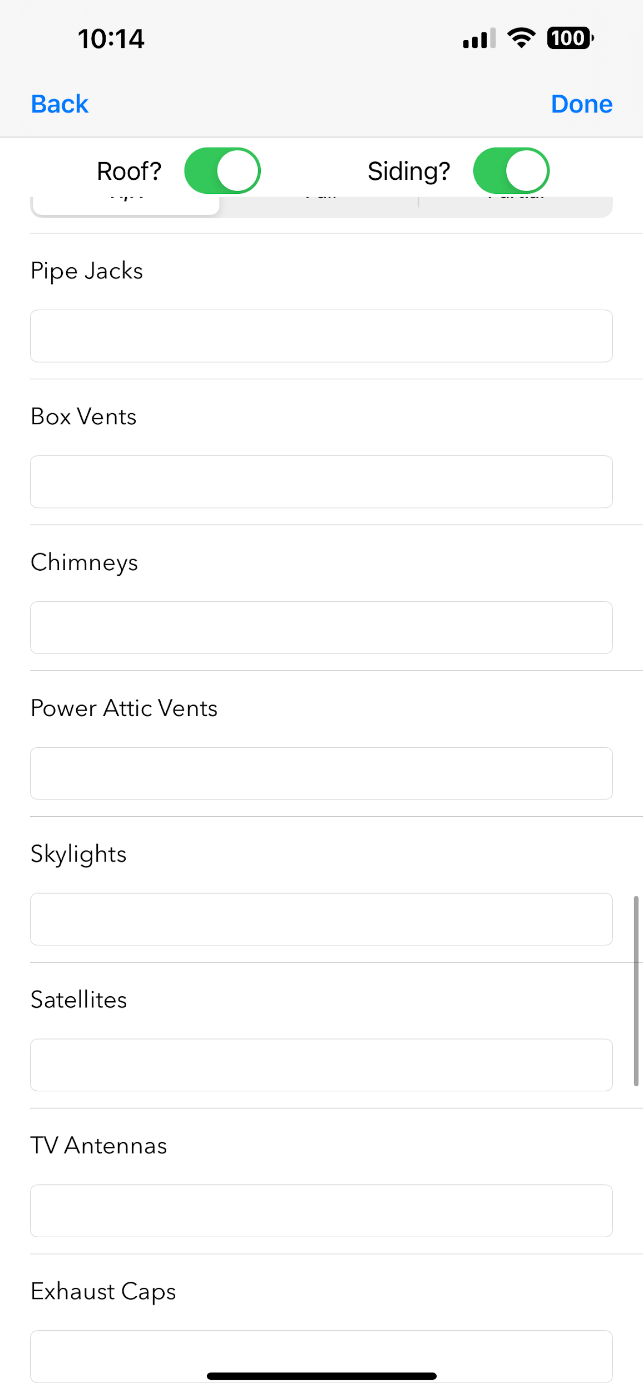
Photo Reports

Slide 61
Quiz
You can add an Adjuster Meeting to your Google Calendar through the Field Portal App – True or False?
Should you CC the Homeowner when you are scheduling an Adjuster Meeting on your calendar?
What time and day is our Weekly Sales Meeting?
What is the Homeowner’s incurred cost outlined in the Contingency Agreement?
When is that cost paid?
Briefly explain what the Claim Authorization allows?

Slide 62
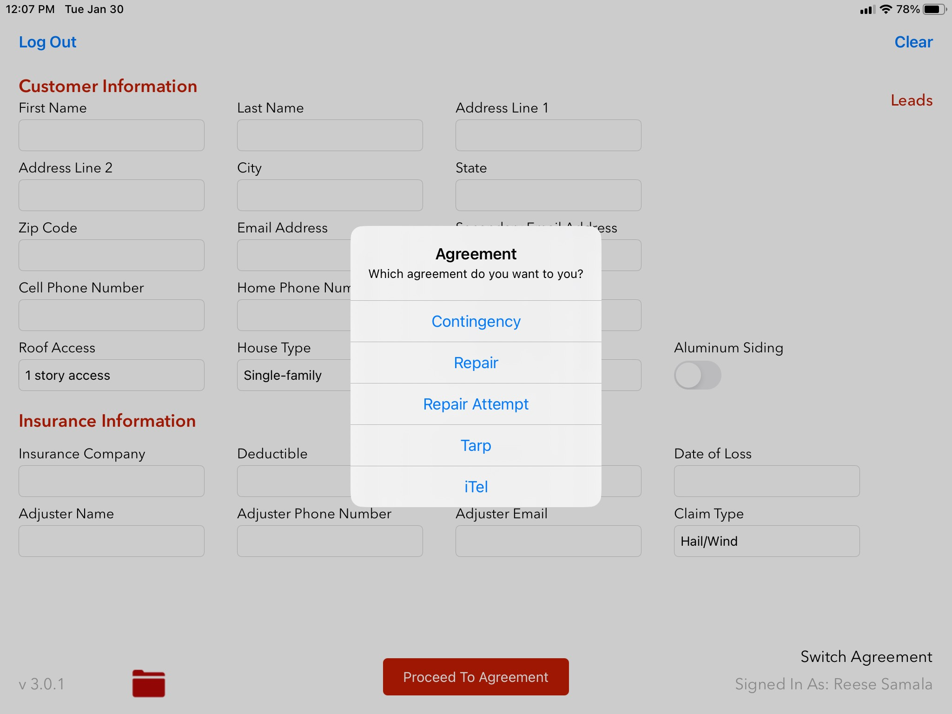
Sales App: Other Agreements
Try this in your iPad
Navigate through each agreement

Slide 63
Recap
Please Review Scripts!
Lean on your trainers for understanding of the technology that we use
Be active on GroupMe
Be in and ready to start tomorrow at 1000am

Slide 64
Roof-ER Sales Training
Welcome:

Slide 65
Put Everything Together
Break into groups
Review as much of the script as you can without having to read off of it.

Slide 66
Partials - Expectations
Not all of your jobs will be approved the first time
Do not get discouraged
Remember, insurance companies are looking for ways to save an extra penny at the expense of their policy holders
Work with your trainers on how they turn jobs around
Reach out to me
You will hear a lot from me on your first few claims, I will give you all the steps necessary to find success for the ones that end up a partial or denial.

Slide 67
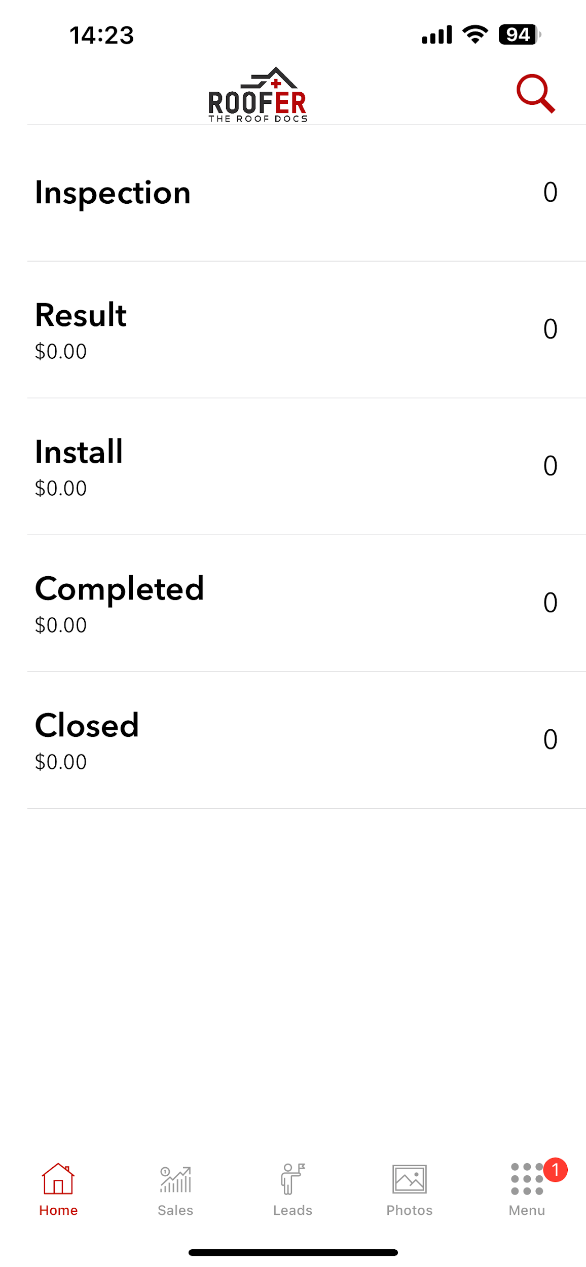
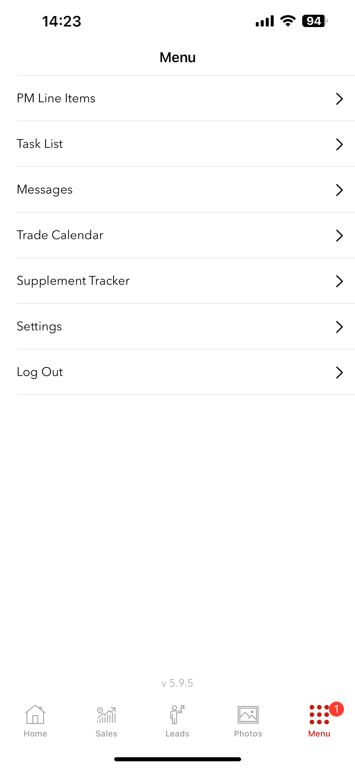
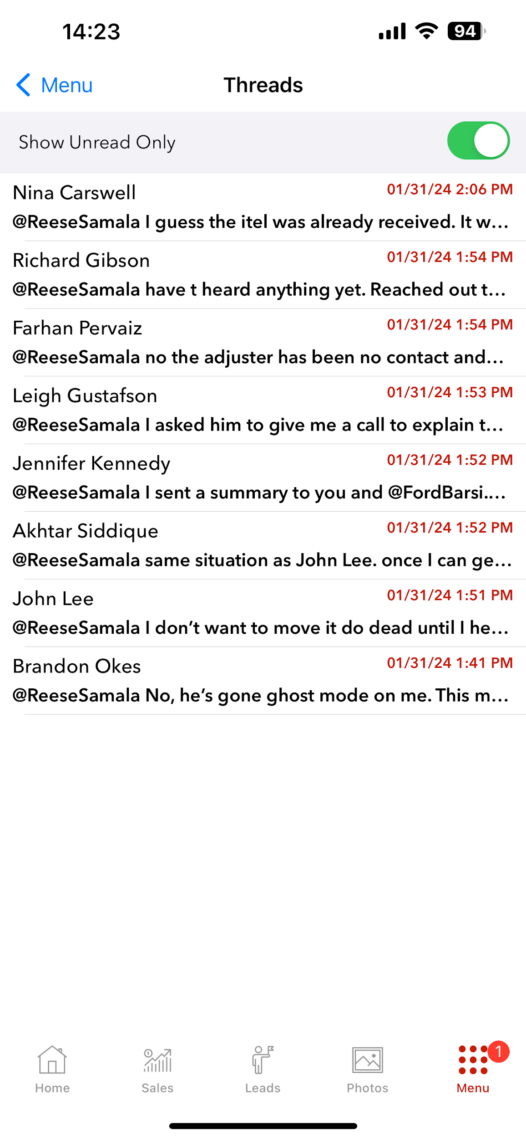
Field Portal: Message Board
After 2 weeks of not responding to messages, your job will be reassigned to someone else.

Slide 68

Field Portal: Tasks

Slide 69
Job Stages & Organization
We will review each job stage
It is easiest to stay organized by using the Field Portal website on a computer or laptop

Slide 70

Field Portal: Trade Calendar

Slide 71
Adjuster Meeting and Photo Reports
Attend the next 2 or 3 Adjuster Meetings with your Field Trainer
Have your Field Trainer or someone in leadership assist you with your first 2 Adjuster Meetings
Adjuster Meeting DO’s:
Show up 15 – 30 minutes early. Let the Homeowner know that you’ll be waiting for the Adjuster/Ladder Assist to arrive before you begin the inspection
Chalk up metals the day before (Not shingles)
Build rapport with the Adjuster/Ladder Assist
Be confident and tactful when interacting with the Adjuster
Always be present when the Adjuster/Ladder Assist is interacting with the Homeowner
Adjuster Meeting DO NOT’S:
Do not get on the roof on the day of the AM before the Adjuster gets there
Do not be confrontational or argumentative with the Adjuster
Do not be a push over but instead tactfully explain your position if there happens to be a disagreement
Do not start taking your Photo Report and Hover photos while the Adjuster is conducting the inspection – offer assistance in any way. Avoid taking pictures during the inspection unless there is a clear opportunity to (I will give an example here)
Photo reports are always taken with the phone in PORTRAIT ORIENTATION. Landscape oriented photos will not populate properly

Slide 72
Hover Reports
You will always use the Hover App – but it launches from your Field Portal App. Your trainer will show this to you.
Photos can be taken in Portrait or Landscape orientation – Landscape is usually more effective

Slide 73




Photo Reports

Slide 74




Photo Reports

Slide 75


Photo Reports

Slide 76


Photo Reports

Slide 77


Photo Reports

Slide 78


Photo Reports

Slide 79


Photo Reports

Slide 80
Quiz
You should already be on the roof when the Adjuster arrives for an Adjuster Meeting – True or False?
Where is Step Flashing typically located?
What is important to find when you find Step Flashing?
Where is Counter/Apron Flashing typically located?
During your Photo Report, you should always hold the phone normally (Portrait Orientation) NOT in the Landscape orientation - True or False?
What orientation can your phone be in for the Hover Report?
Can you access the Field Portal through a website on a computer or laptop?

Slide 81

Script Review
More review (Practice Makes Perfect!)
If you are “Cleared to Sell” today, you can start signing up deals!

Slide 82
Recap
Continue to review using the Field Portal App and Sales App
Continue to memorize and perfect the entire script
Attend Adjuster Meetings with your Field Trainer
Make sure you inform your Field Trainer of your own Adjuster Meetings so that they can be there or have someone else assist you with your first 2 Adjuster Meetings
Please be in and ready to start at 1000am tomorrow

Slide 83
Roof-ER Sales Training

Slide 84


Shingle Quiz

Slide 85


Shingle Quiz

Slide 86


Shingle Quiz

Slide 87

Shingle Quiz

Slide 88
Google Drive

Slide 89
Additional Scripts
We will briefly review the remaining scripts
Continue to review on your own and with your Field Trainer
We will dive a little deeper into the Post AM Script and Full Approval Estimate Phone Call (not required to memorize)

Slide 90
Email Templates
We will briefly review these now
Be most comfortable with Post AM Email Template

Slide 91
Average Ticket/Tracking Sales
Average ticket as a company is between $23k - $25k
This average varies greatly per sales rep!
Naturally, sales reps who have been here longer have average tickets of $30-$40k+!
While, on the other hand, newer reps will sometimes have average tickets of $15-20k or less.
Tips to increase average ticket
Take pictures of hail damage to:
DOWNSPOUTS and GUTTERS
WINDOW WRAPS
WINDOW SCREENS
ALL METALS THAT CAN POTENTIALLY BE DAMAGED BY HAIL
METAL ROOFING ESPECIALLY OVER WINDOWS OR PORCHES
Track your sales
Sales Tracker

Slide 92
Technology
Let’s take some time, if needed, to answer any technology questions that you may have

Slide 93
Common Abbreviations
HO = Homeowner
FU = Follow Up
AM = Adjuster Meeting
SF = State Farm
PC = Project Coordinator
PM = Project Meeting
Supp = Supplement
RA = Repair Attempt
WND = Work Not Doing
LVM = Left Voicemail
ACV = Actual Cash Value
DP = Downpayment
PA = Public Adjuster
CP = Completion Payment
CF = Completion Form
FP = Final Payment
IWS = Ice Water Shield
PIS = Post Install Supplement
WU = Wrap Up
FT = Field Tech
INS = Insurance
OOT/OOO = Out of Town/Office
AR = Accounts Receivable

Slide 94
Review
We have reviewed a lot
Continue to review and reach out to your Field Trainer or anyone else with any questions
BUT – even if you do not remember anything else from this training – CONSISTENCY IS KEY
Knowing the script perfectly will not help if you are not out there making it happen
We can GUARANTEE success if you are doing consistently what you are doing with your Field Trainer this week – five or six times a week knocking 60, 70, or 80+ doors a day

Slide 95
Quiz
What resource has templates, additional documents, our licenses/certification, and a lot of other useful information?
Analyze this sentence: “HO LVM with SF asking about ACV. HO has not received ACV and cannot pay DP. FU on 15 March at 4pm.”
HAVE A GOAL

Slide 96

Final Script Review

Slide 97
Mission and Values
Our Mission:
At Roof-ER, our mission is to hold a fiduciary responsibility to our customers - plain and simple. In an industry known for poor workmanship, lack of communication, and at times, outright deceit; we seek to restore the name of exterior remodeling contractors nationwide. By committing to our core values of Integrity, Quality, and Simplicity, we promise to deliver an experience every homeowner wants when remodeling their home: a simple and straightforward quality installation for a fair and honest price.
Our Core Values:
Integrity: At Roof-ER, we set the standard for Integrity in an industry that has lost credibility among many consumers. We do not only set the standard of integrity with our clients, but it starts with being honest to ourselves. We have the courage to truly see ourselves, recognize where we can grow, and implement changes to meet the demands of reality.
Quality: We guarantee the highest Quality in our products and services. Our confidence in our craft propels us into the elite 2% of all roofing companies in the entire nation. Quality starts with the moment a client interacts with one of our representatives at the door. The Quality demonstrated in every aspect of what we do continues to make Roof-ER the gold standard of this industry.
Simplicity: We strive to deliver an overwhelmingly positive experience for everyone who interacts with Roof-ER. By embracing the complexities of our industry, we provide exceptional results to our clients. Our clients value the Simplicity of partnering with us – we guarantee a seamless process from start to finish ensuring satisfaction with the final outcome.
Check out this Yelp Review!

Slide 98
Let’s Make it Happen!!!!
Please feel free to reach out to me (Reese) any time. If I do not answer, I will always return your call. You can also text or email me any time.
Please stay in contact with your Field Trainers and lean on them for continued success
Ensure you are already aware of your weekend training days with your Field Trainer this weekend.
You can also reach out to Oliver or Ford whenever you need them
Get Sign Ups – Get those bonuses – Close those houses – be the next Roof ER success story!

